Slide 1
Getting started with Power Virtual Agents
Hugo Bernier

Slide 2
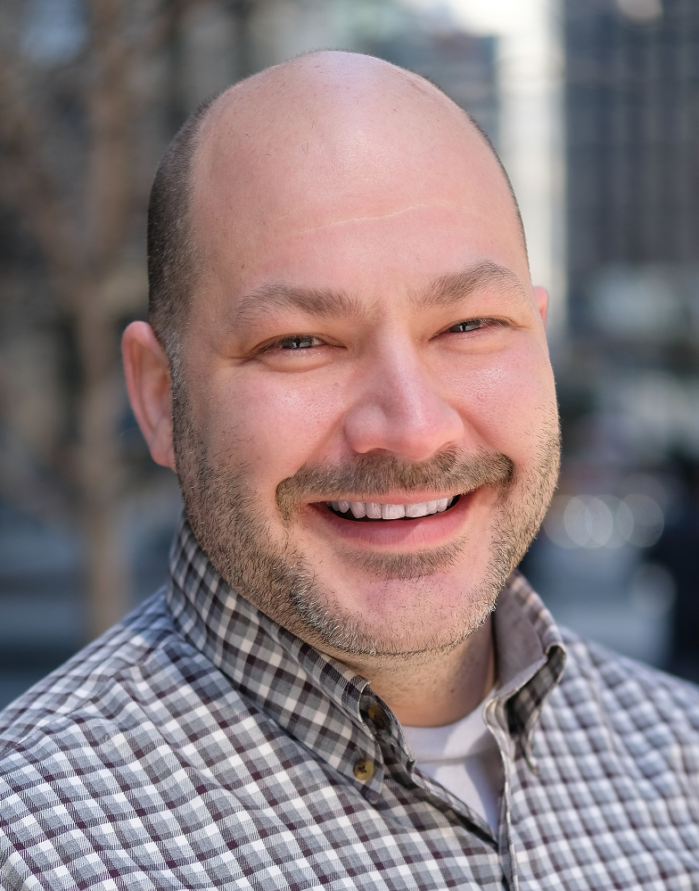
About Me
Director of Consulting Services, Point Alliance
Founder Toronto Citizen Developer User Group
@bernierh
TahoeNinjas.blog
Notes:
(Yikes! this is a big picture of me)

Slide 3
2001
Notes:
So… I like to tell stories in my presentations.
This presentation isn’t any different.
In 2001, I had the opportunity to work on a project in Singapore where we were building a knowledge management portal using a preview Microsoft product called Tahoe.
The product came with some DLLs and many many pages built in VBScript.
The cool thing about that was that if you knew VBScript, you could read all the source code for it and understand how it worked…
When it was released, the product was eventually renamed to SharePoint (Portal Server).

Slide 4

McKinsey & Company
Notes:
The consulting company was McKinsey & Company.
They had offices in 73 countries and wanted their consultants to be able to find resources and documents, find information about other consultants (to find experts about a topic), and – because they travelled a lot – needed to find information about each one of their offices.
We used SharePoint to store all that information.
Except that back in 2001, there was no easy way to access information over a mobile phone.
That was back when accessing data over a mobile phone was just in its infancy, and it was too expensive.

Slide 5
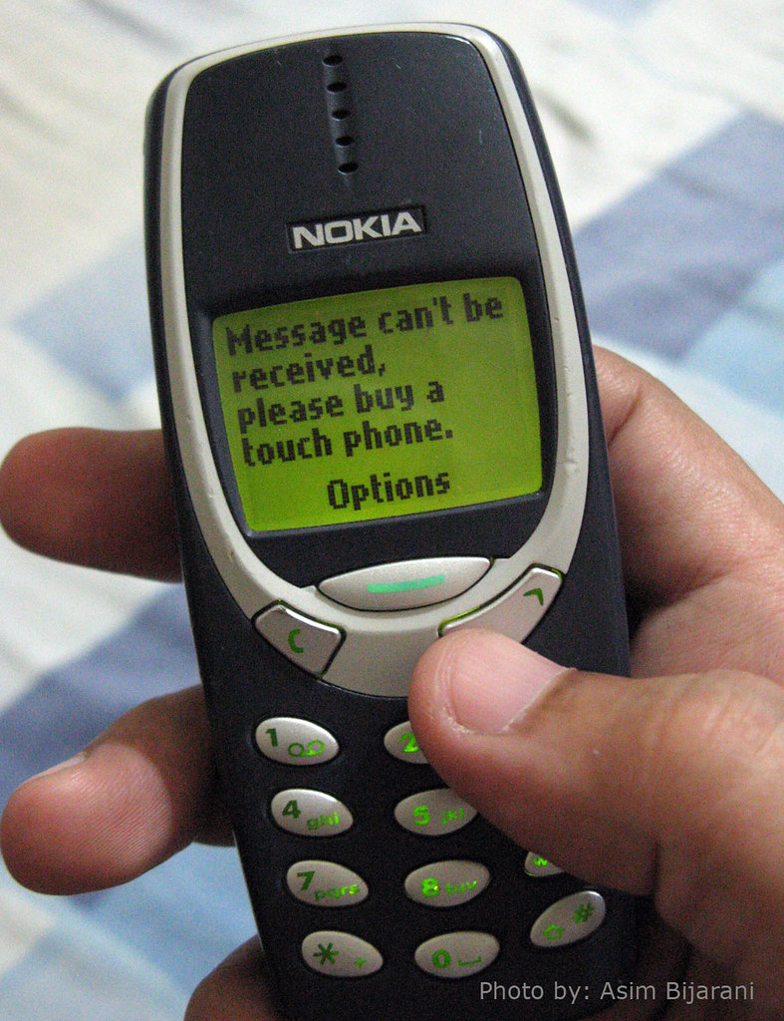

NOKIA
Notes:
However, most cell phones could send text messages. It was still in its infancy in North America, but in Europe and Asia, text messaging was widely used.
So, we bought a $19 nokia phone, and a $100 nokia data cable, connected them to our server as a modem, and wrote some VBScript code to respond to incoming text messages to query our SharePoint server and return information over text messages.

Slide 6
NOKIA
Notes:
This slide is hidden because it contains a special font. Next slide is an image of the text.

Slide 7

Notes:
Any consultant could write a short text message to our mobile “bot” and they would get a reply containing the information they wanted.
We could verify that the person asking for information was an employee because we had everyone’s cell phone number in our employee directory.
We’d use the sender’s cell phone number to authenticate, but we’d also use it to keep track of who was asking what, and keep a sense of “context” for each conversation.

Slide 8
who john smith
Notes:
This slide is hidden because it contains a special font. Next slide is an image of the text.

Slide 9

Notes:
For example, you could ask
WHO then the name of a person, or the partial name

Slide 10

Found 4 people
John Smith, TO/CA
John Smith, NY/NY
John Smithers, BO/MA
Johnny Smiths, FR/DE
Reply # for more information
Notes:
This slide is hidden because it contains a special font. Next slide is an image of the text.

Slide 11
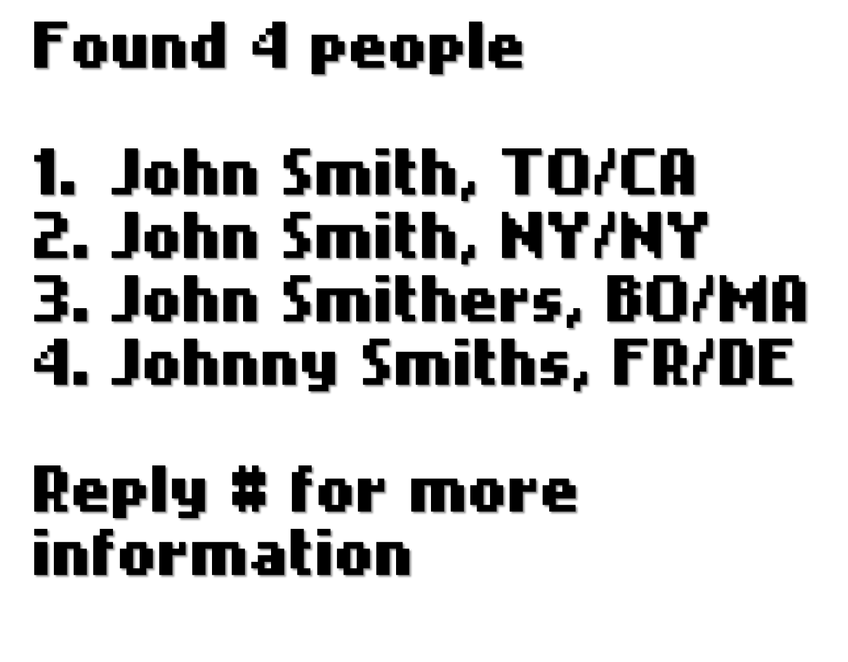
Notes:
It would return the list of people with a matching name.
If you wanted more information, you could simply reply with the number associated to each name in the list.

Slide 12
where Toronto
Notes:
This slide is hidden because it contains a special font. Next slide is an image of the text.

Slide 13

Notes:
If you wanted to find information about an office, you could send
WHERE and the name of an office, a city, or a country
For example, you could write WHERE TORONTO to find the Toronto office information

Slide 14
McKinsey Toronto 110 Charles Street West
Toronto, ON M5S 1K9
Canada
Voice: +1 (416) 313 3700
Fax: +1 (416) 313 2999
Notes:
This slide is hidden because it contains a special font. Next slide is an image of the text.

Slide 15
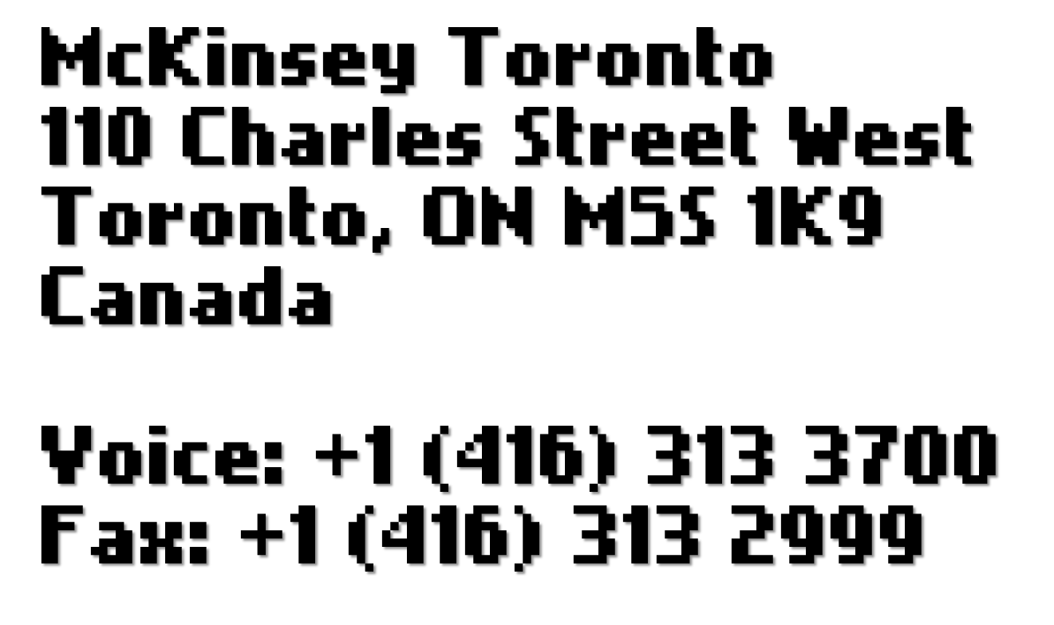
Notes:
…and you would get address and contact information for the matching offices

Slide 16

Notes:
This slide is hidden because it contains a special font. Next slide is an image of the text.

Slide 17
what pd195764
Notes:
And if you wanted to get a document from the firm’s famous PDNET – their renown repository of sanitized studies. – you could pass the PDNET number or part of the title and it would find matching documents

Slide 18
Found 1 matching document
PDNet 195764
E-Business Builder Handbook, 2000
795 pages
Reply email, fax, summary
Notes:
This slide is hidden because it contains a special font. Next slide is an image of the text.

Slide 19
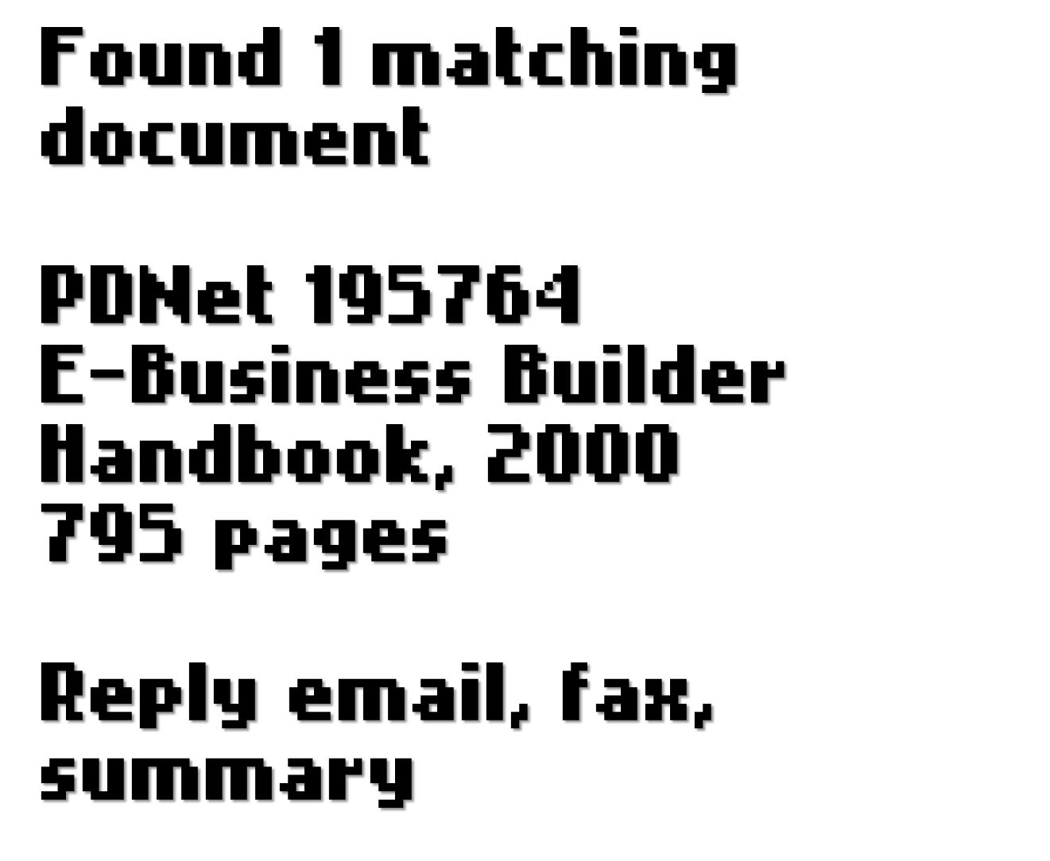
Notes:
Once you found the document you wanted, the system could email the document, fax it, or send you a summary over text.
We had to write all the logic to authenticate the sender, parse the text message, determine the sender’s intent, find the information they wanted, and send a response back with the information.
If we wanted to add new intents (e.g.: who, what, where), we had to write completely new code to parse the text, search the info, return the results, etc.

Slide 20
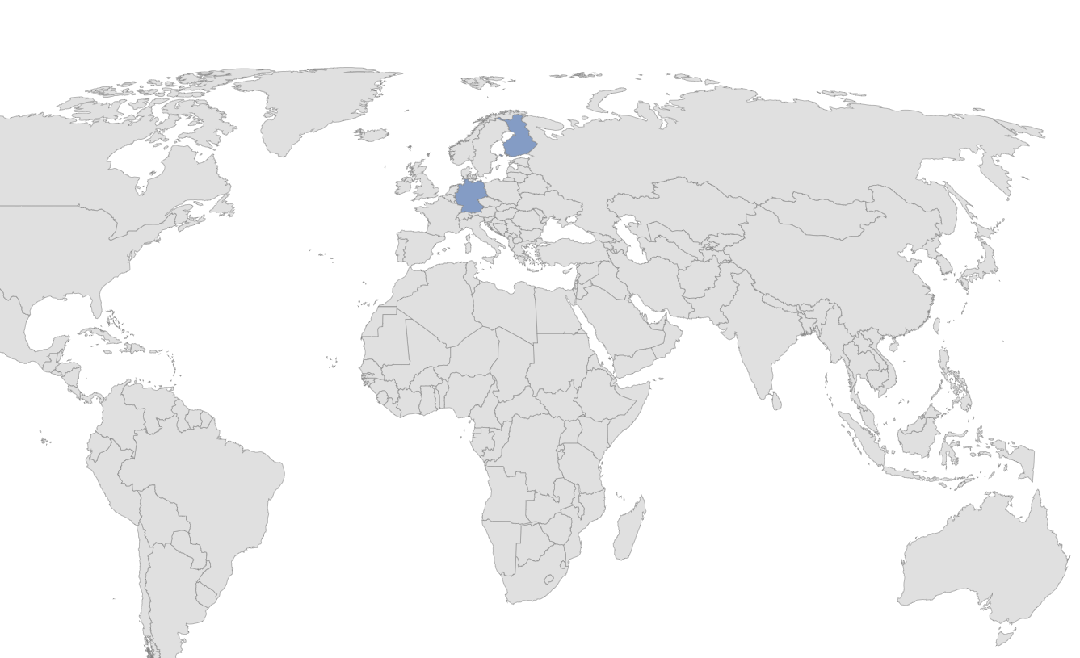

Notes:
I was due to demo this new portal in Germany and Finland, so I looked up my itinerary before flying out of Singapore, wrote down the address to Munich and Helsinki offices and got on my flight

Slide 21
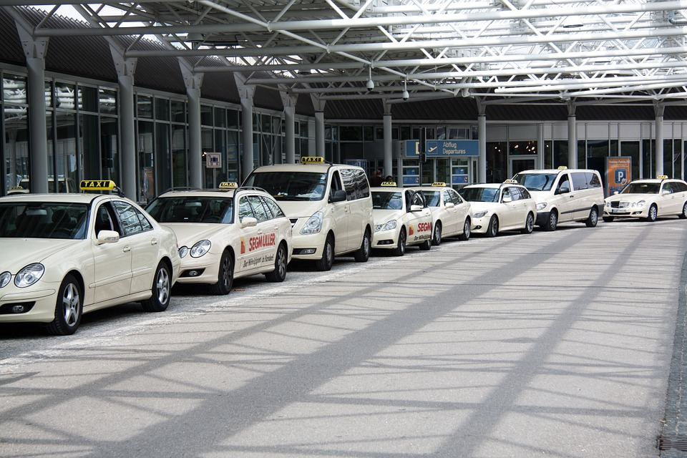
Notes:
When I landed in Munich, I get in a taxi and I give the driver the address to what I thought was the Munich office in the best German I can muster.
But the driver tells me that the address doesn’t exist.
Turns out I wrote the address to the Helsinki office.
I don’t know where the Munich office is. I have the phone number for the Helsinki office, so I try calling them to ask for the Munich office address, but Helsinki and Munich are one hour difference, and the Helsinki office isn’t open yet.
Remember, that was before we could just look up any address on a mobile phone.
The taxi driver is getting mad at me. I’m sweating bullets.

Slide 22
where munich
Notes:
Then I remember that I’m here to demo the portal and the mobile capabilities.
So I text WHERE MUNICH to the portal’s mobile bot.

Slide 23
Munich Office
Tal 24, München
Bayern 80331
Voice: +49 89 24233412
Notes:
And I finally get the response from our bot.
I triumphantly tell the annoyed taxi driver the address:
Tal 24
The driver immediately says:
“Ah, McKinsey!”

Slide 25
2018
Notes:
Fast forward 17 or so years later.
Working for a large college in Ontario.
We built an Office 365/SharePoint portal that gave students information about their timetables, their student advisors, maps, etc.
We used the C# bot framework to build our own chatbot.

Slide 26
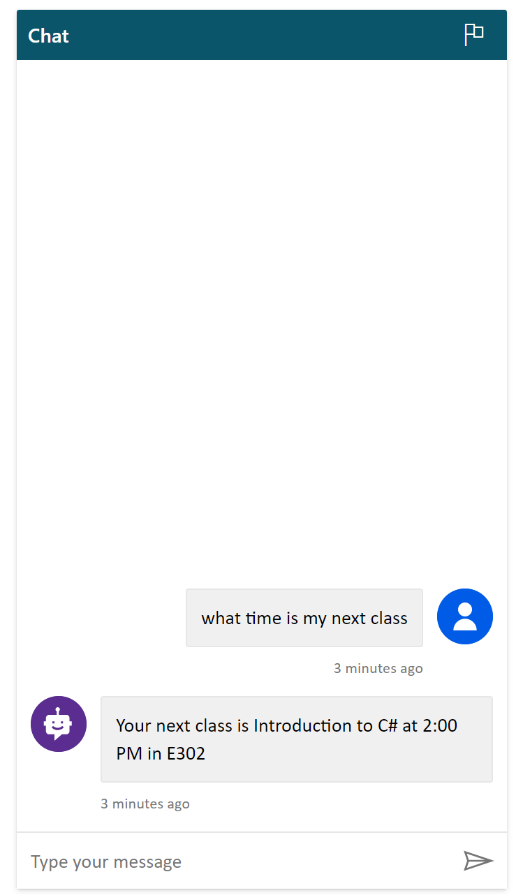
what time is my next class
Notes:
Students could ask things like what time is my next class to get their timetable information.

Slide 28
Notes:
(In the real solution, any reference to a room number would also give a map to the room)

Slide 29
when’s my next class
Notes:
Because the bot framework uses LUIS to parse natural language, we were able to use a more natural language when talking to the bot. For example, we could use “what time”, “when”, “how long before” interchangeably.

Slide 30
next class?

Slide 31
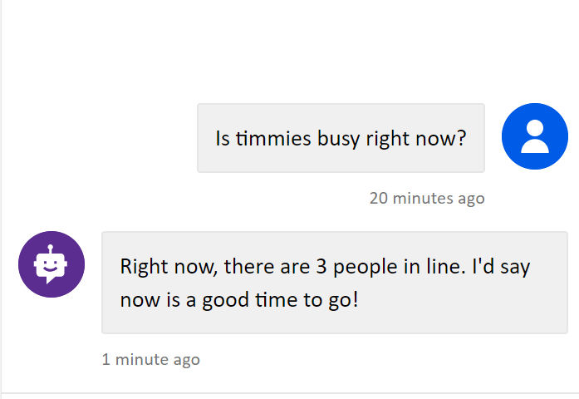
Is timmies busy right now?
Notes:
We were also able to integrate with Azure Cognitive Services. For example, we could analyze a web cam feed to see how many people were in line for a restaurant in the cafeteria and help the students get to the coffee shop when it wasn’t busy.
We were also able to use Sentiment Analysis (in Azure Cognitive Services) to detect if the student’s “tone” was getting more angry or more sad and encourage them to get in touch with their advisor.

Slide 32

Intuitive
Notes:
As you can see, bot technology has evolved. It allows us to build an intuitive interaction with our users (because we intuitively know how to talk to people).

Slide 33

Portable
Notes:
It was also portable, because our users could access the resources from anywhere from their phones, tablets, or workstations.

Slide 34

Difficult to maintain
Notes:
However, every time we wanted to add more functionality, we had to either custom write our language parser or re-train the parser and add more code to handle new topics.

Slide 35
Getting started with Power Virtual Agents
Explain “why bots”
Demonstrate how to build a Power Virtual Agent
Discuss real-life applications
Discuss licensing
Notes:
That’s where Power Virtual Agents come in.
Today, we’ll explain why bots are useful, we’ll demonstrate how to build your first power virtual agent and how to use them in real life.
We’ll also talk about everyone’s favorite subject: licensing.

Slide 36

Why bots?
Notes:
But why would you want to build a bot?

Slide 37
85%
Source: Gartner
Notes:
According to Gartner, by the end of 2020, 85% of all online interactions will occur without another human.
Bots are a more natural interface for users than an app.
http://www.gartner.com/imagesrv/summits/docs/na/customer-360/C360_2011_brochure_FINAL.pdf

Slide 38

69%
Source: Forrester Research
Notes:
And according to Forrester, 69% of IT decision makers have plans to build a bot within their organization.

Slide 39

How to build a Power Virtual Agent

Slide 40
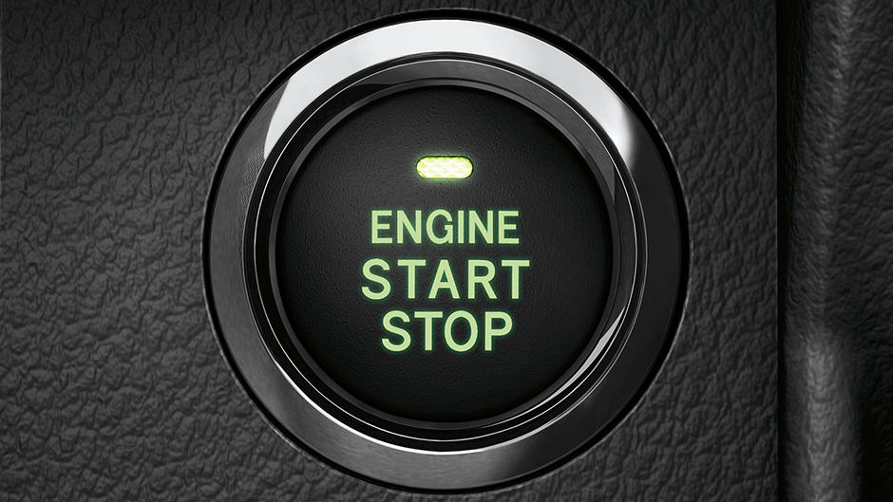
https://aka.ms/TryPVA
Notes:
To get started go to https://aka.ms/TryPVA and set up a trial agent

Slide 41
Demo

Slide 42
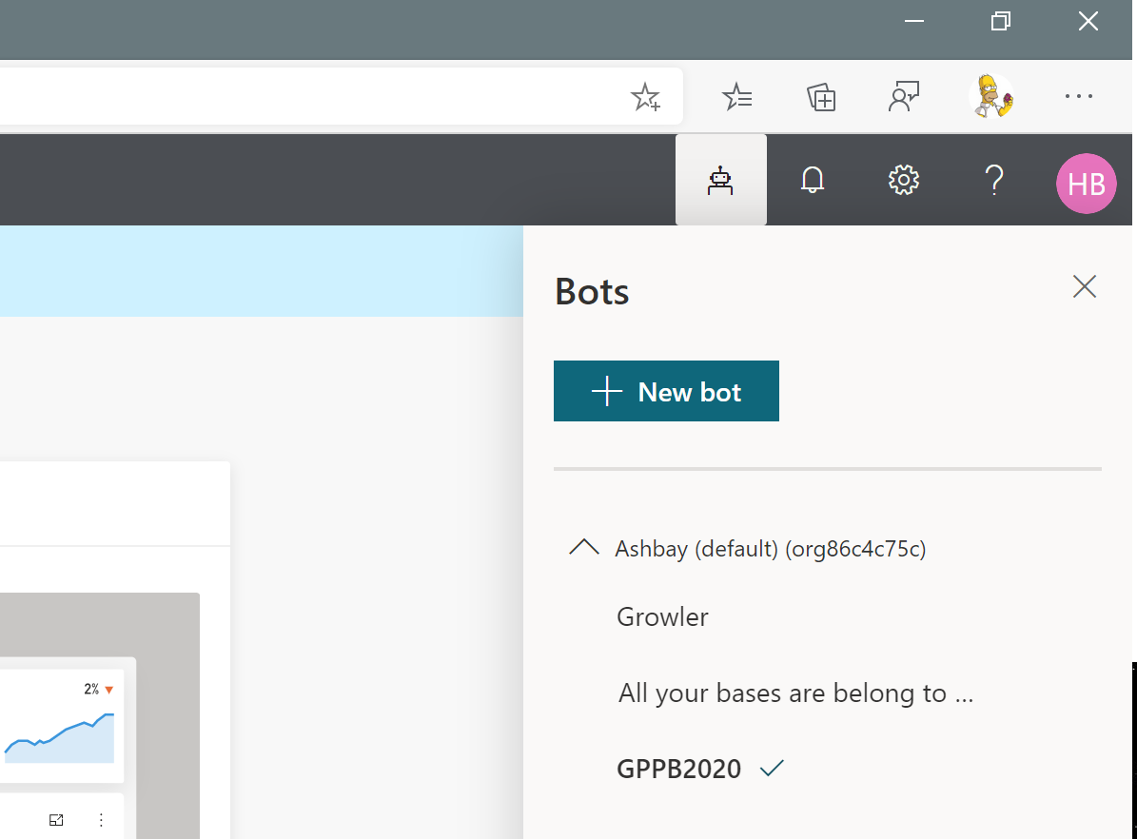
Notes:
To create a new bot, select the bot menu in the upper-right corner, then select New bot

Slide 43
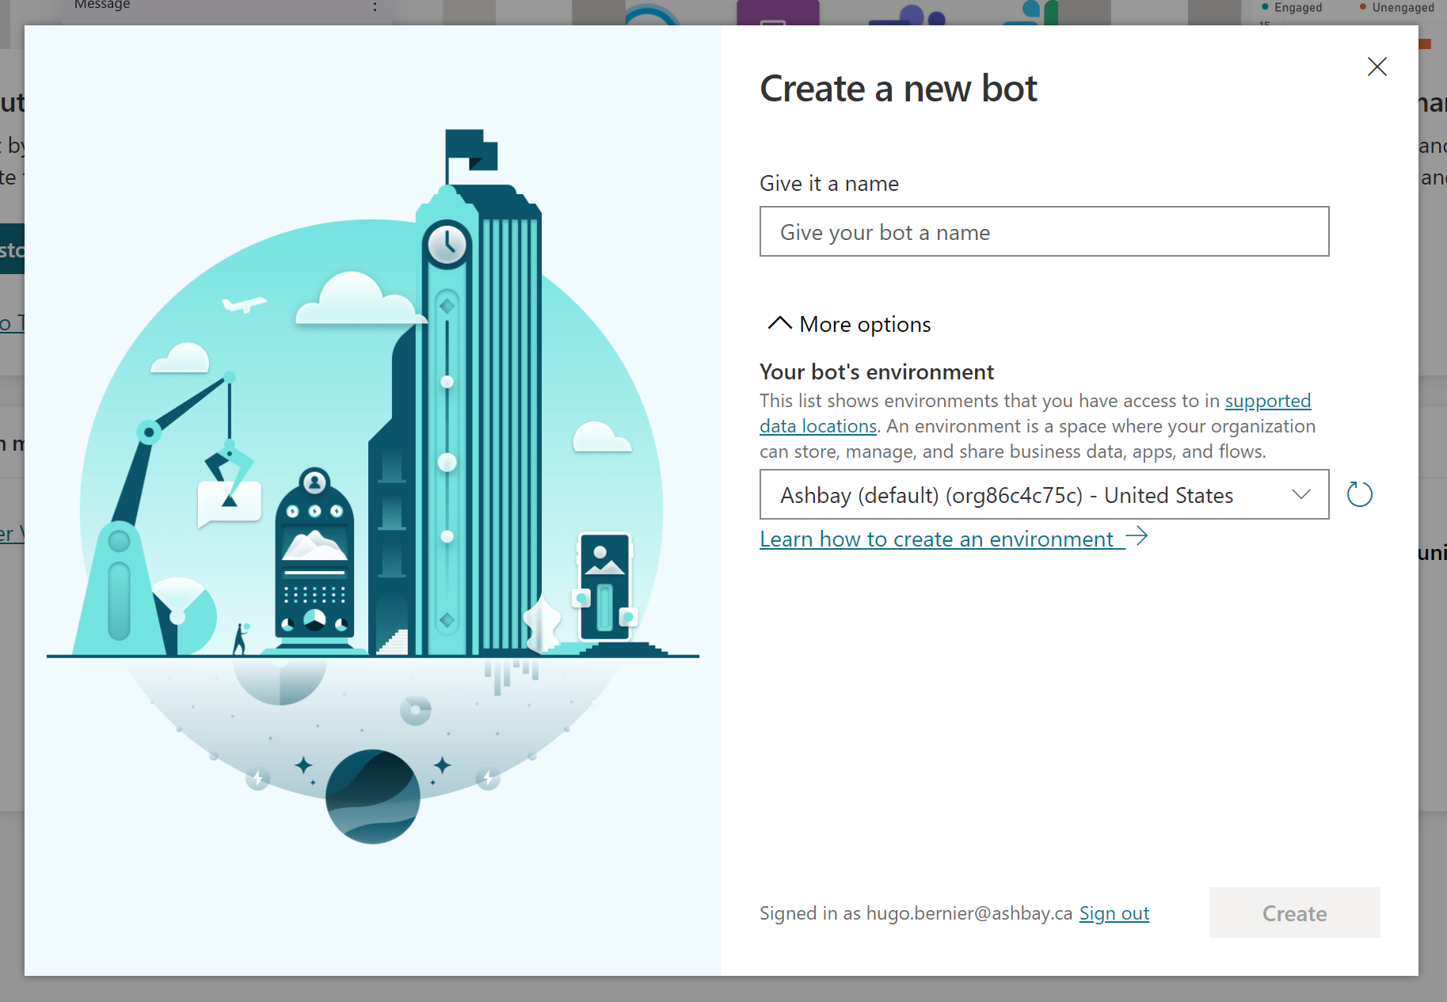
Notes:
Enter a name and, optionally, select the environment you wish to create your bot in.
The environments allow you work in the same tenant without mixing your production, dev, QA environments, for example

Slide 44
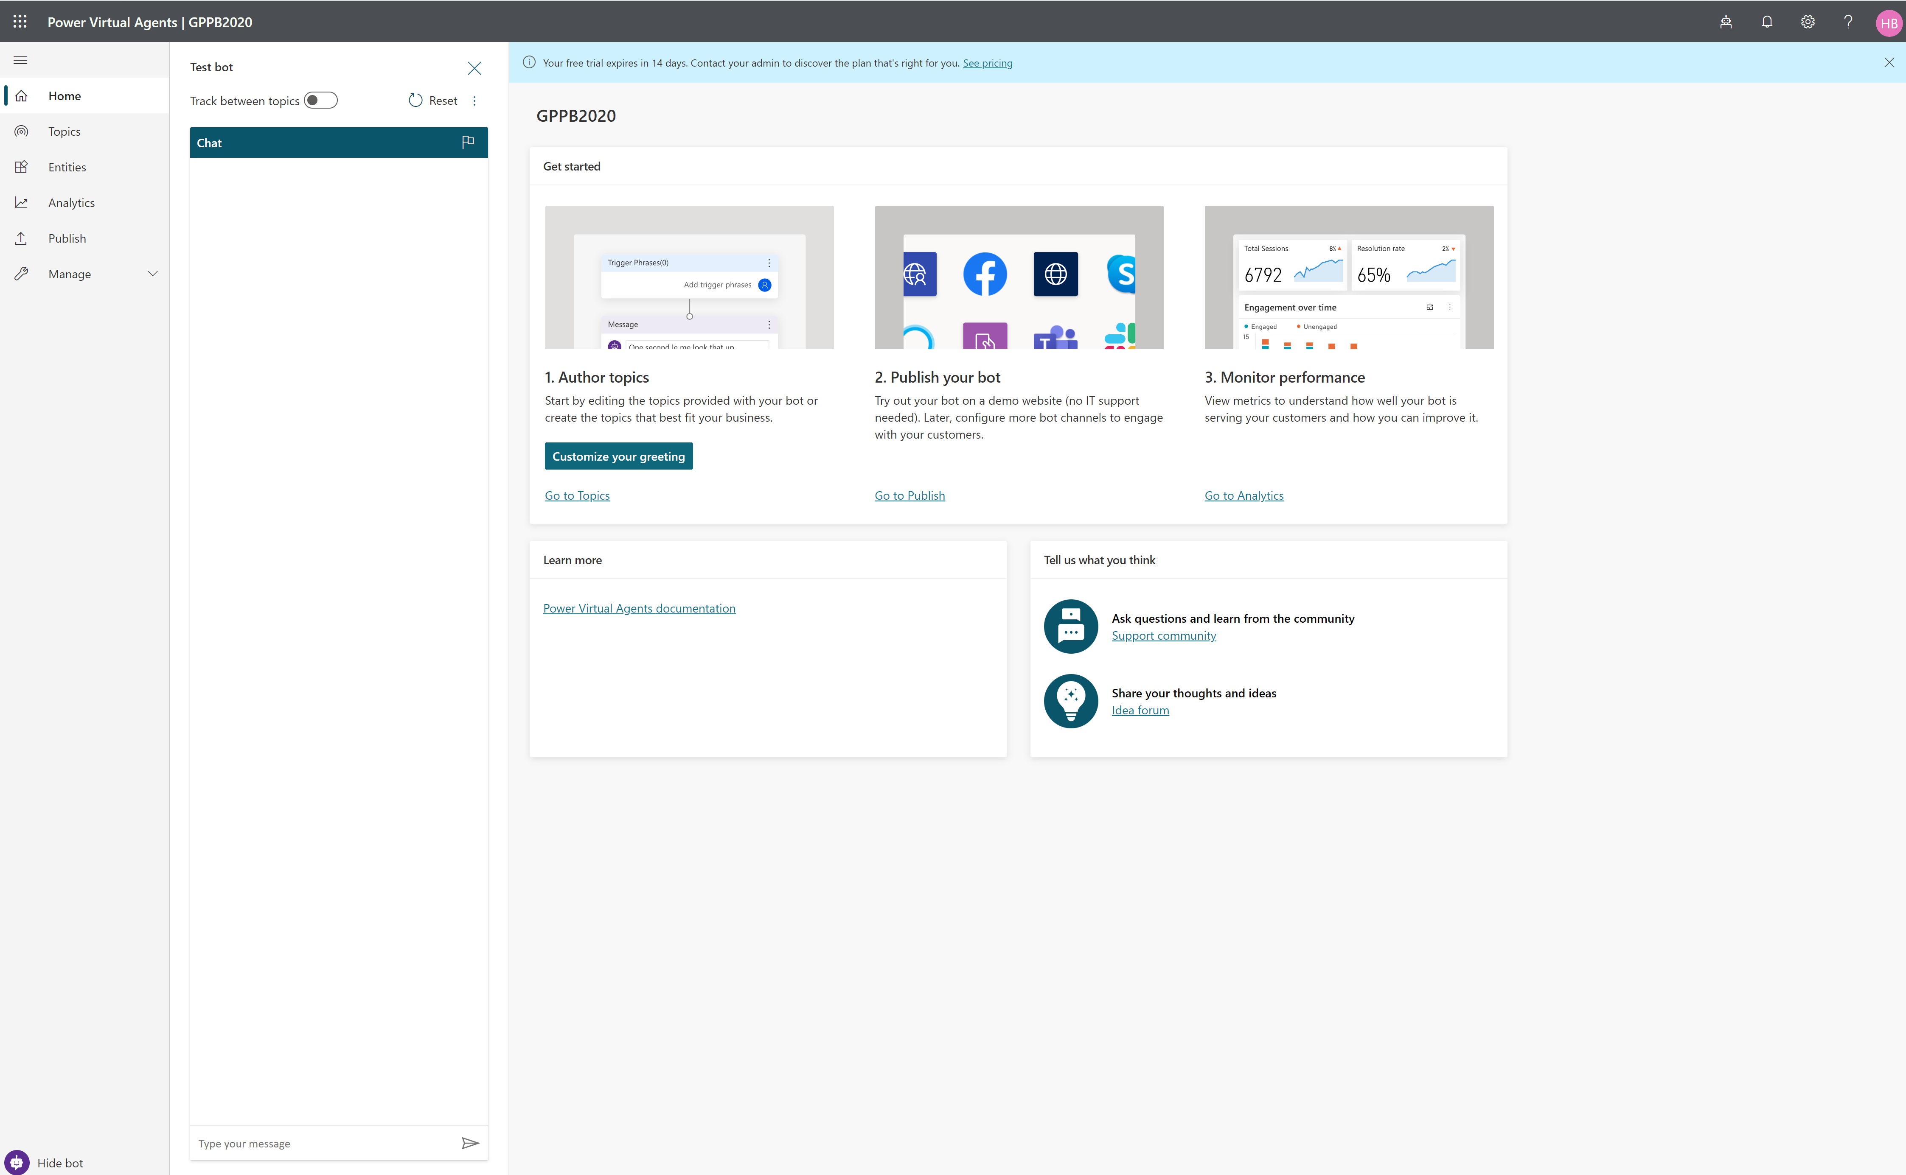
Notes:
Once your bot is created, you need to get yourself familiar with Topics and Entities
Later, we’ll worry about Analytics and Publishing (not in that order)

Slide 45
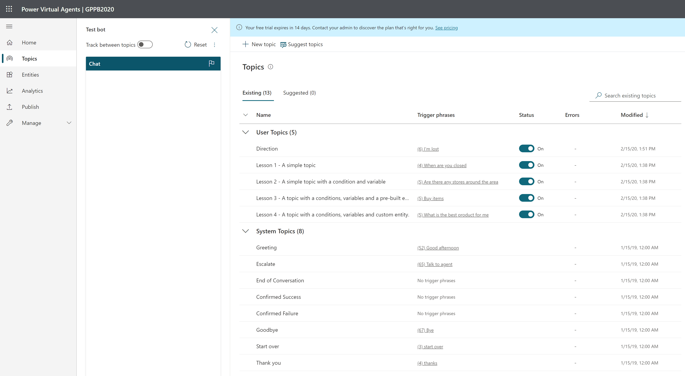
Notes:
In our previous examples, Who, What, Where, and Timetable or How busy a restaurant is were all topics.
There are two kinds of topics: User Topics which are triggered by users and System Topics which are triggered by the system based on an event (like a conversation starting, etc.)

Slide 46
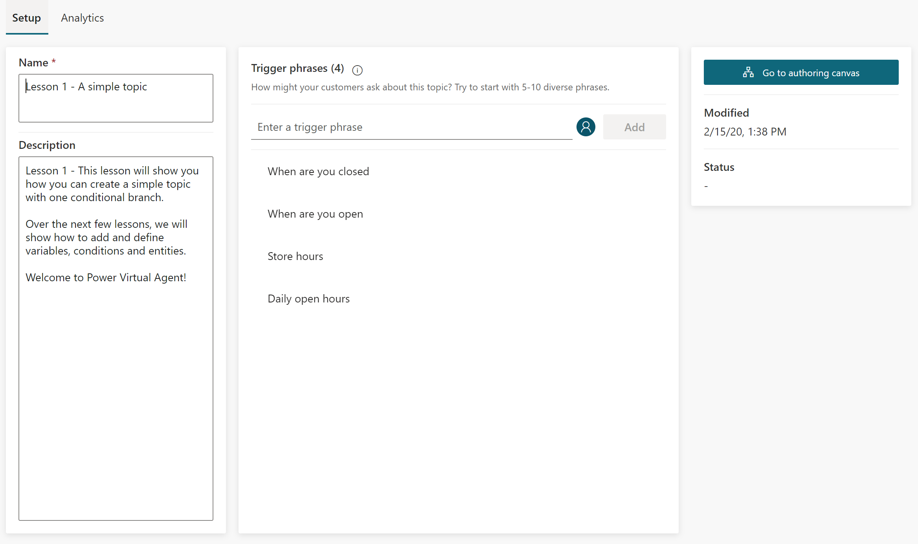
Notes:
Topics have two main areas. Setup and Analytics.
Setup is where you start. Analytics is where you’ll come back after you implemented your bot to improve your bot.

Slide 47
Notes:
User topics are triggered with Trigger phrases.
When you create a new topic, you need to enter 5-10 phrases to teach your bot how to start that topic.
Try writing shorter trigger phrases. 2 to 10 words should do.
Make sure to write very different phrases. Change a word (e.g.: open vs closed) to expand your topic’s coverage.
Adding articles, capitalizations, contractions, or plurals does NOT help. Power Virtual Agent is already great at understanding grammar.

Slide 48
Notes:
Once you wrote your trigger phrases, go to the authoring canvas to create your conversation flow.

Slide 49
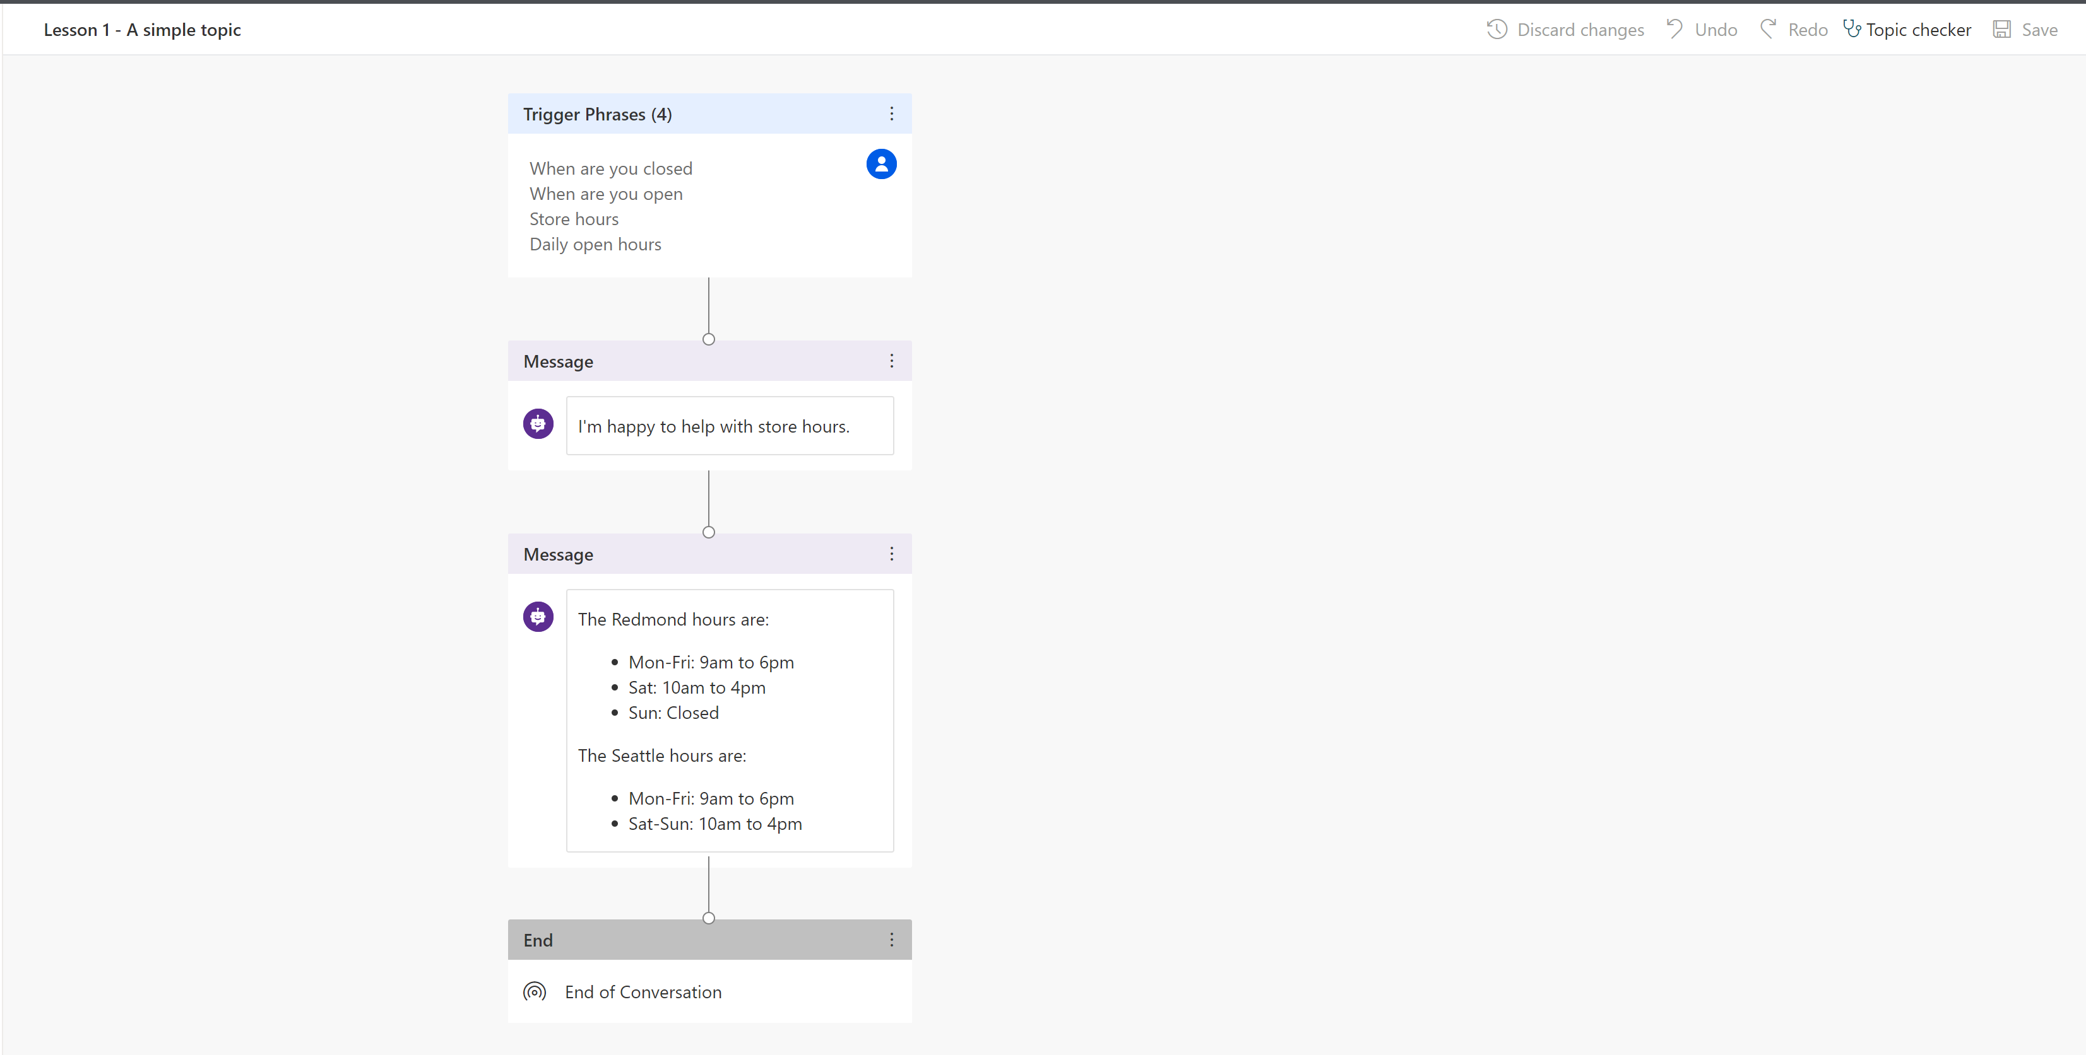
Notes:
In your canvas, you can change the flow of your conversation.

Slide 50
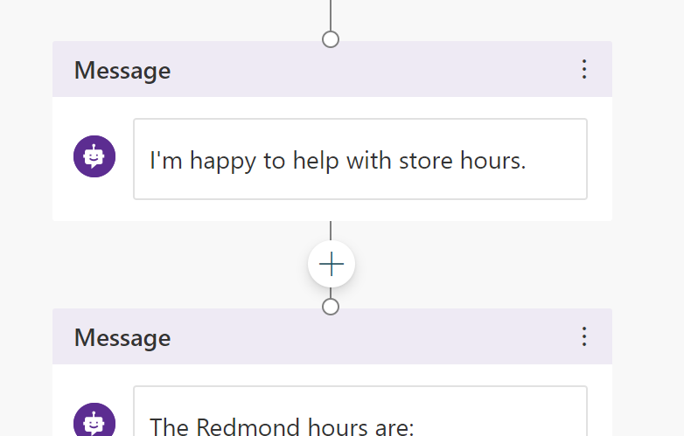
Notes:
For example, you can go at any point in the flow and add a node

Slide 51
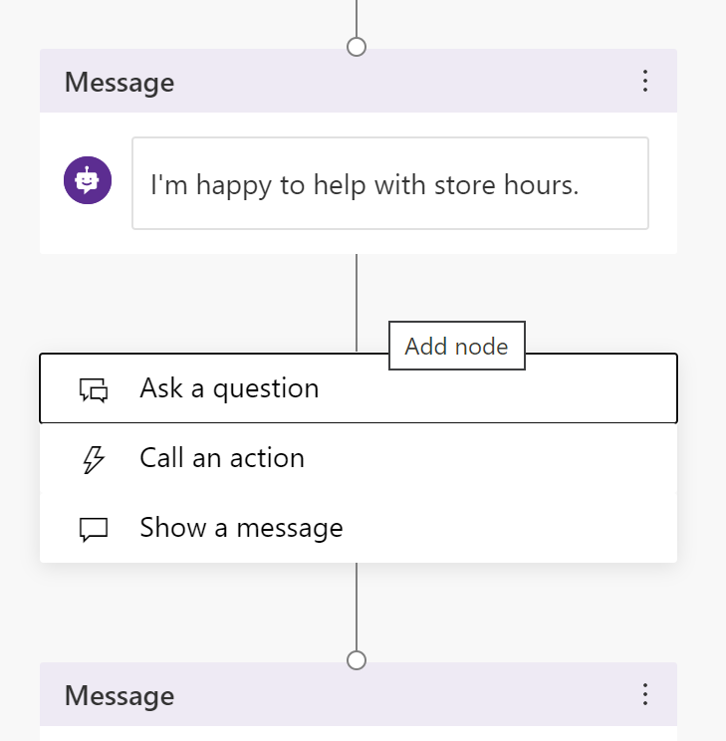
Notes:
When adding a node, you can Ask a question, Call an action, or Show a message

Slide 52
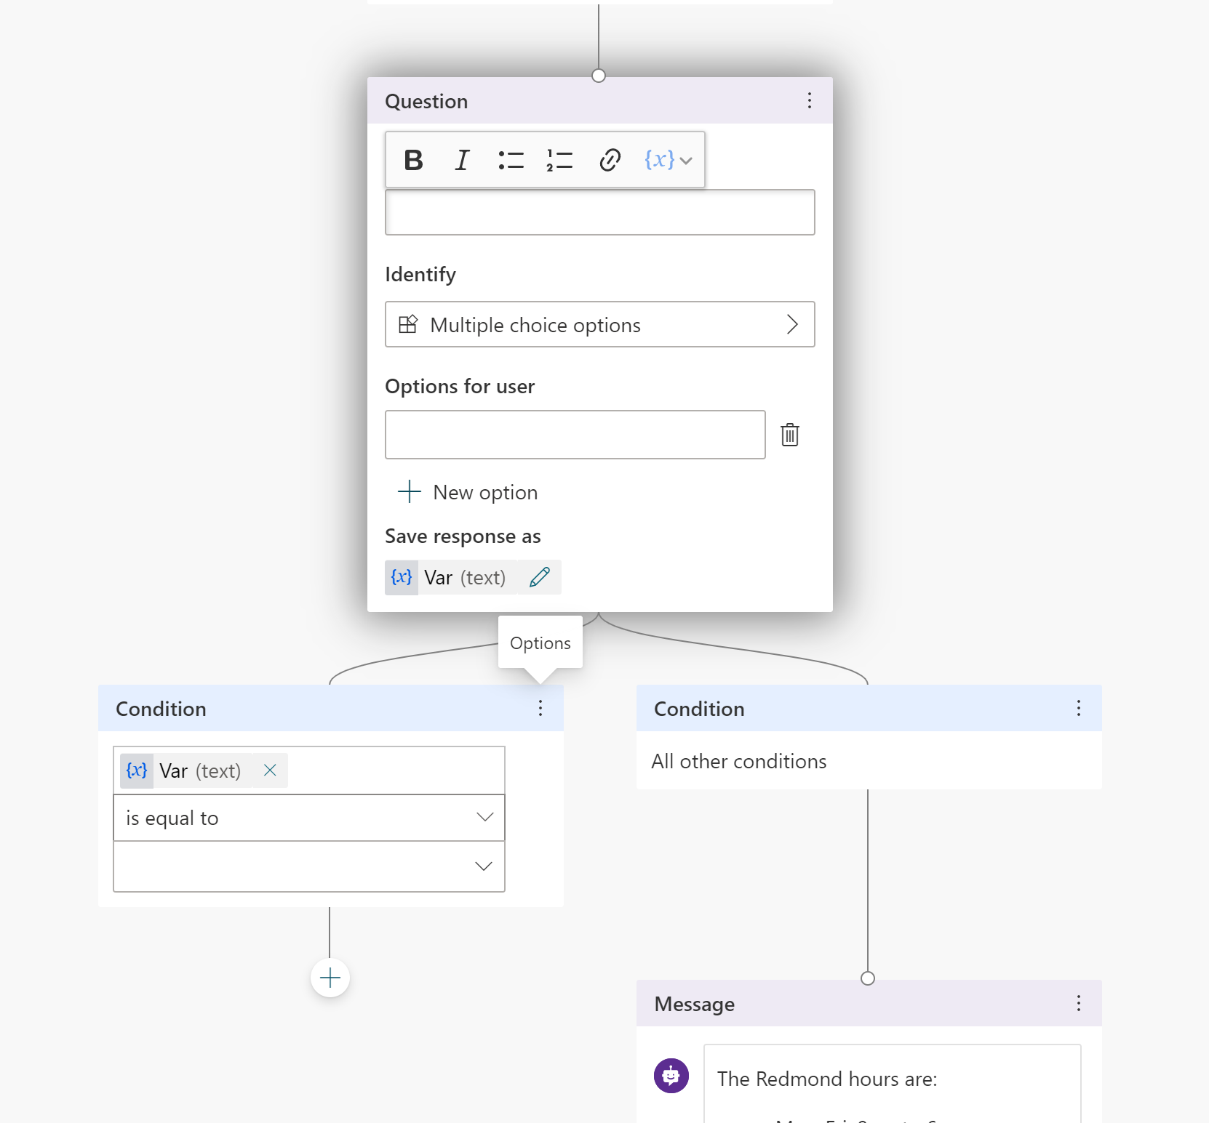
Notes:
Asking a question allows you to prompt the user for input and capture that input in a variable that you can refer to later.

Slide 53
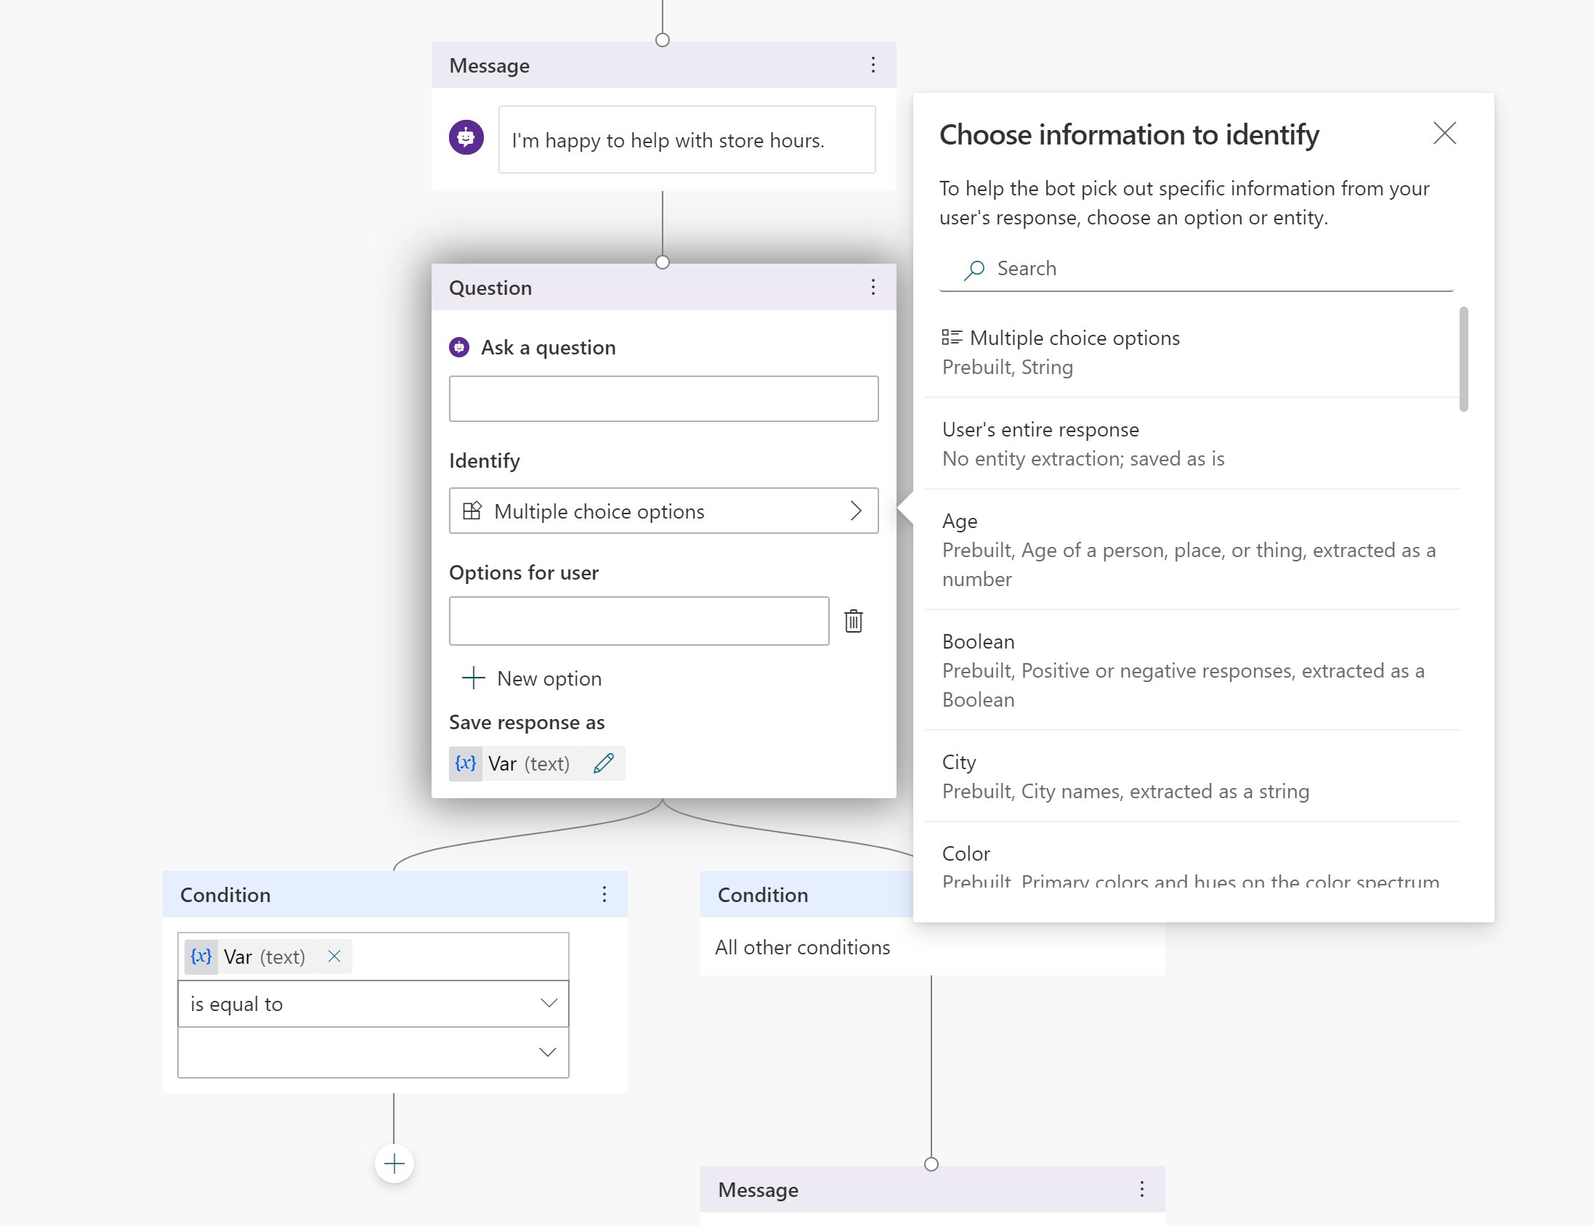
Notes:
You can ask different types of questions that expect different inputs.
You can do Multiple choices, entire responses (where the text isn’t parsed), or use Entities.
We’ll come back to entities shortly.

Slide 54
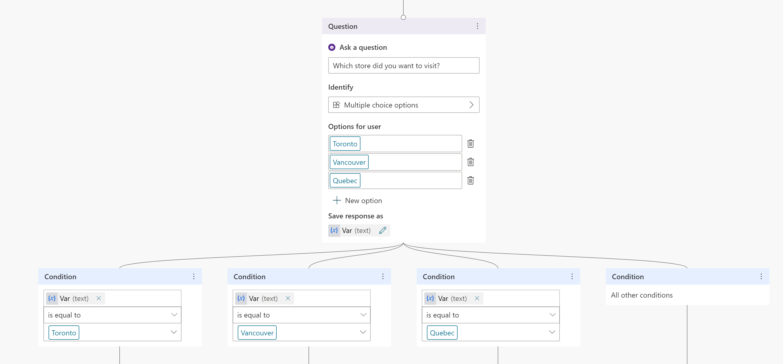
Notes:
For example, where you use multiple choices, the bot will prompt the user to select one of the options.
It will also automatically create a branch for you to react to each response.
You should use multiple choices when you have a limited number of options (maybe 3 to 5). Too many choices will become “invisible” to your users.

Slide 55
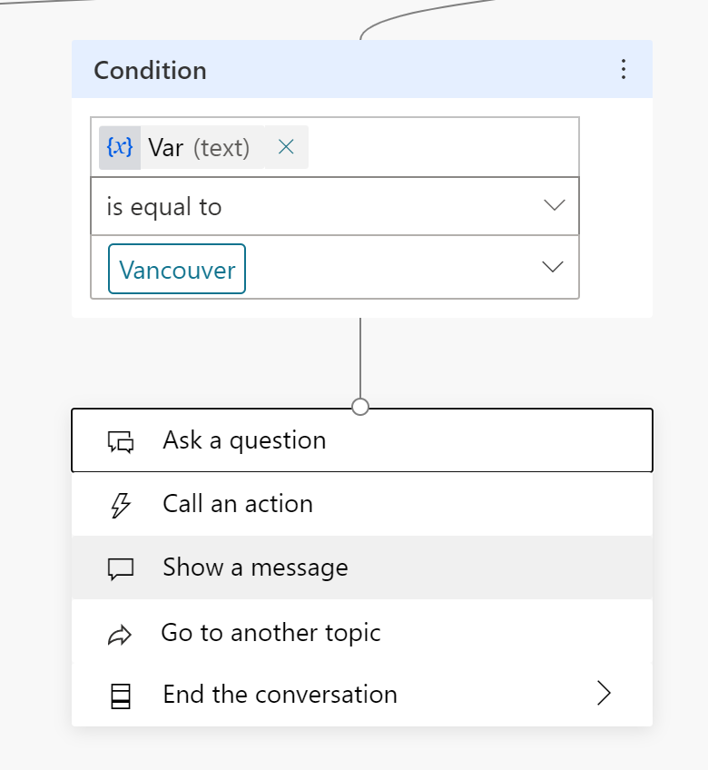
Notes:
The Show a message action will display a message to the user.

Slide 56
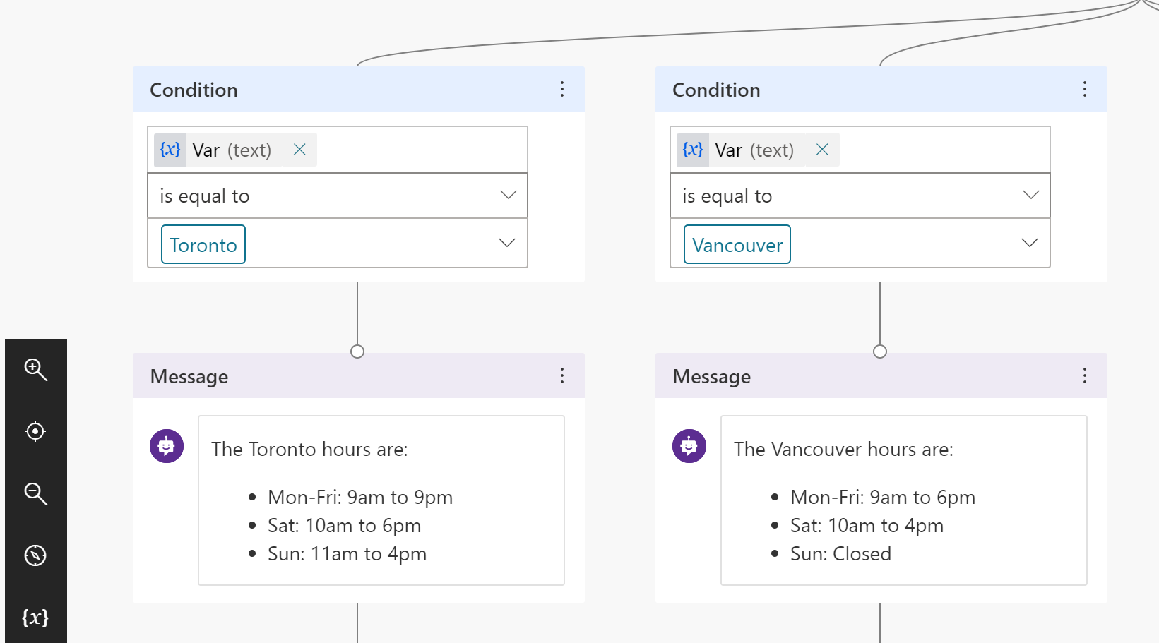
Notes:
For example here, we show a different message based on what the user responds.
If you’re a developer in the room, you’re probably thinking “This is stupid, it should connect to an API or a database and retrieve the store hours instead of ‘hard-coding’ the responses”.
…and you’d be right.
But that’s not the value of Power Virtual Agent. The point of PVA is to allow business people, who are the subject of matter experts on a topic to create bots without needing a developer.

Slide 57
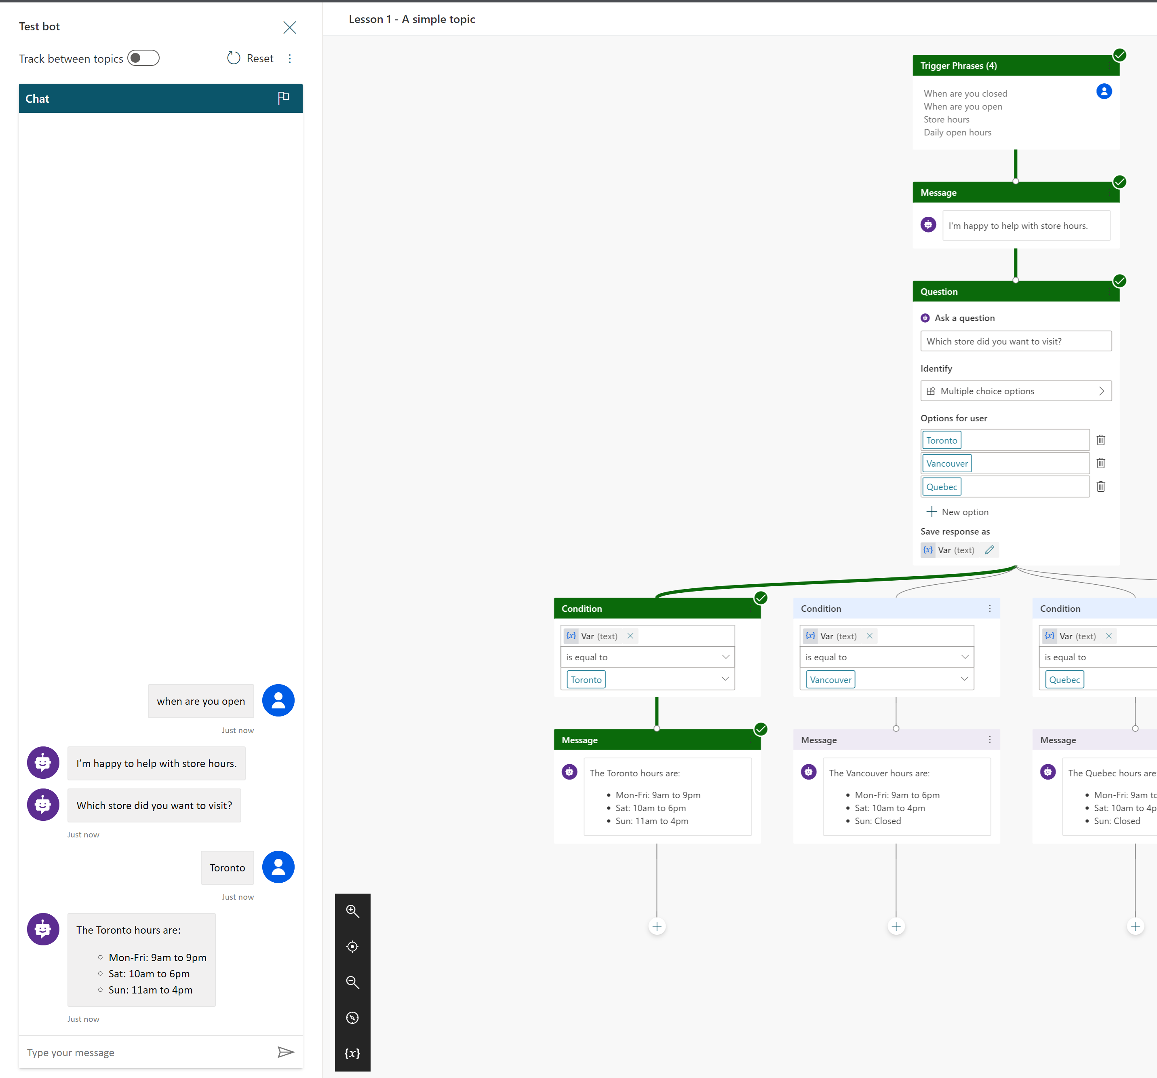
Notes:
Once you Save your changes, you can test the bot by using the Chat window.
Notice how as the chat is going on, it shows you the path it took in the authoring canvas

Slide 58
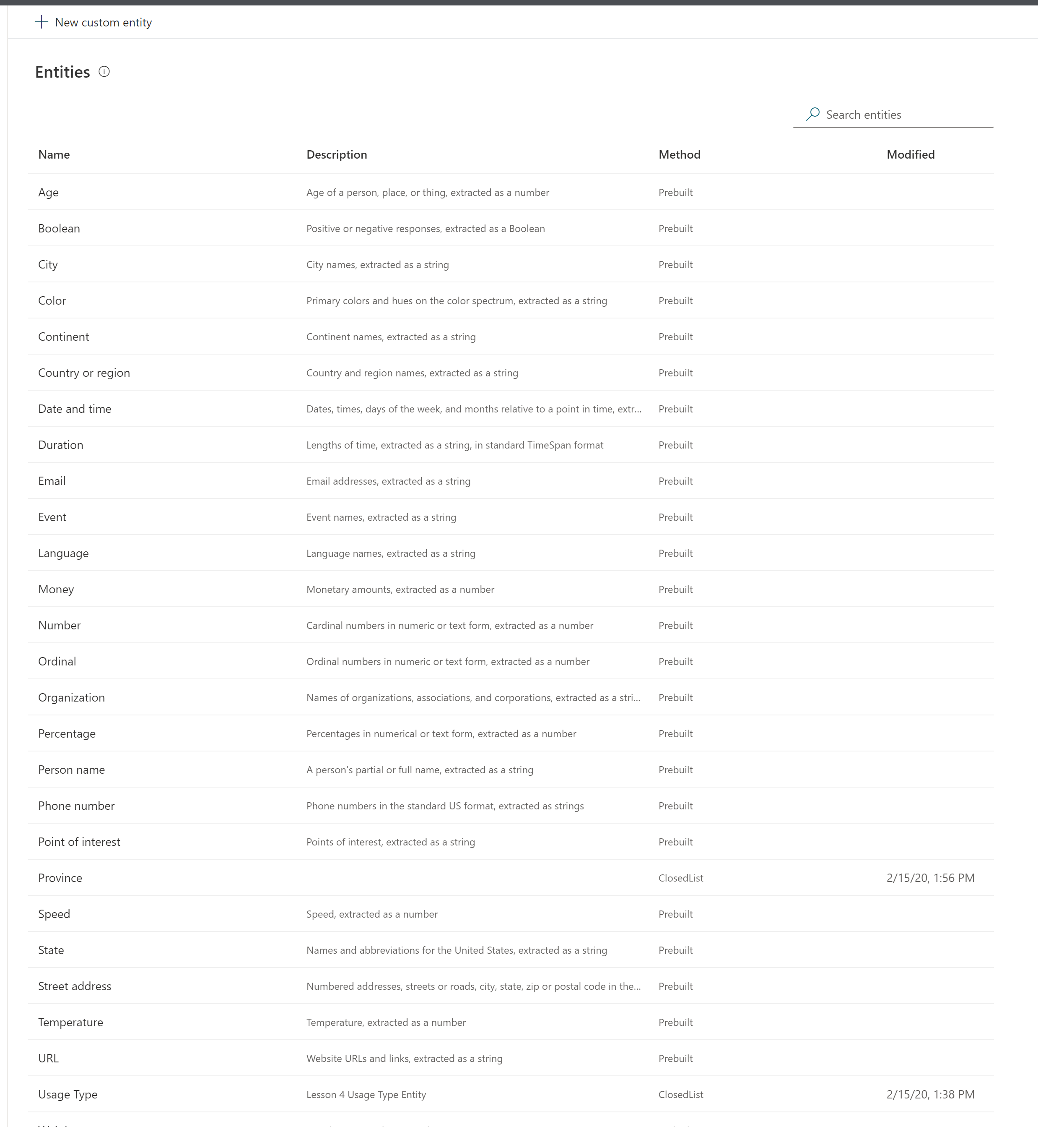
Notes:
You can also use Entities are a valid type of input.
Entities are pre-defined entries that Microsoft has already trained the bot to recognize, or custom entries you’ve created that you want to re-use throughout the bot.

Slide 59
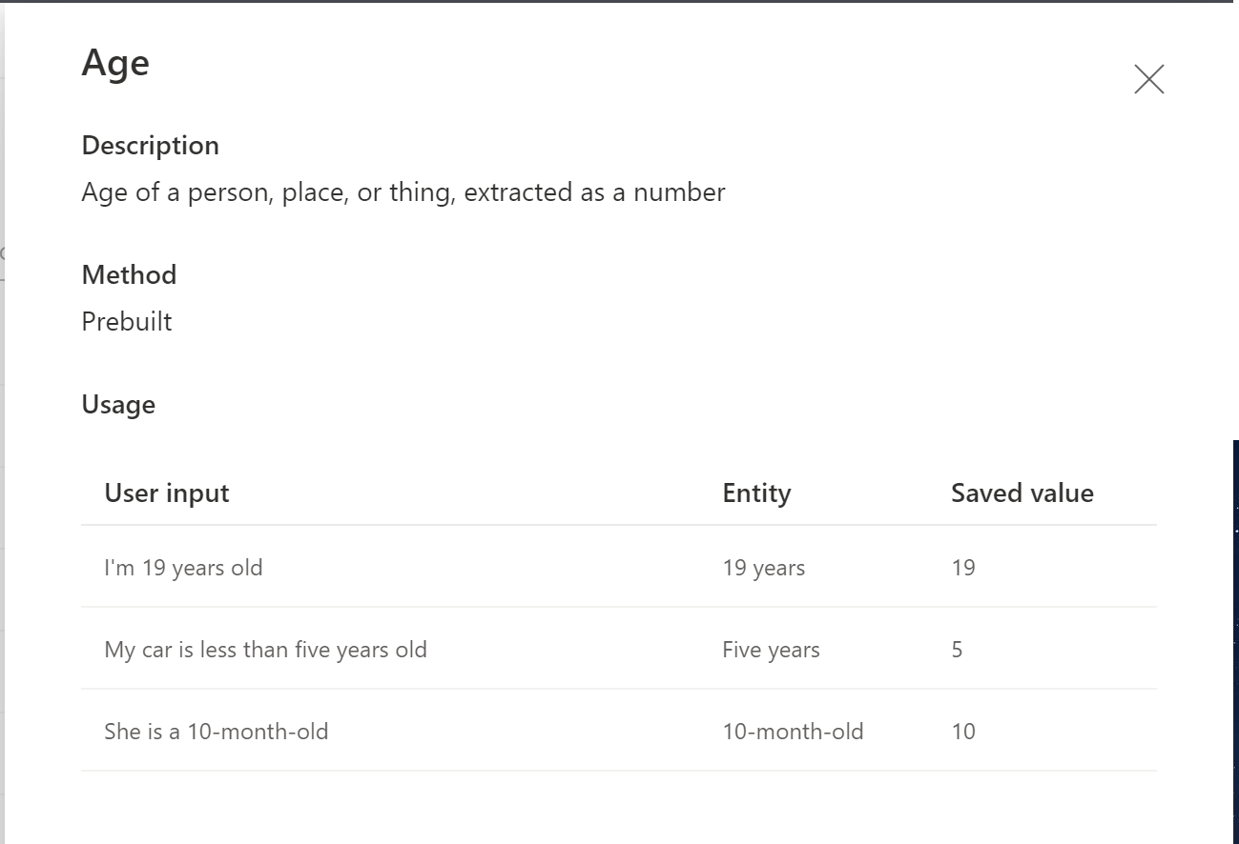
Notes:
For example, the Age entity is a prebuilt entity that knows how to extract someone’s/something’s age from text.

Slide 60
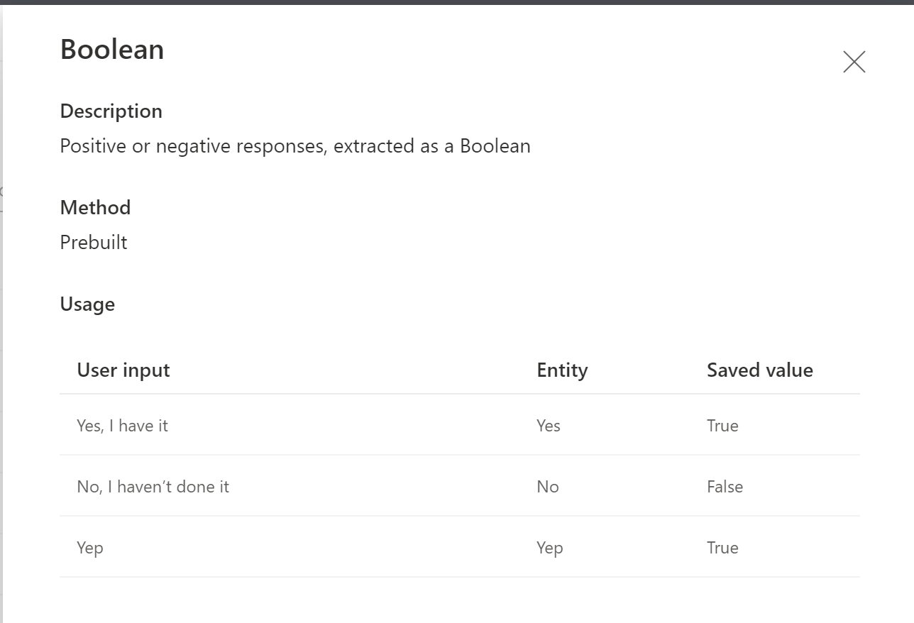
Notes:
Another example is the Boolean entity, which recognizes Yes or No values.

Slide 61
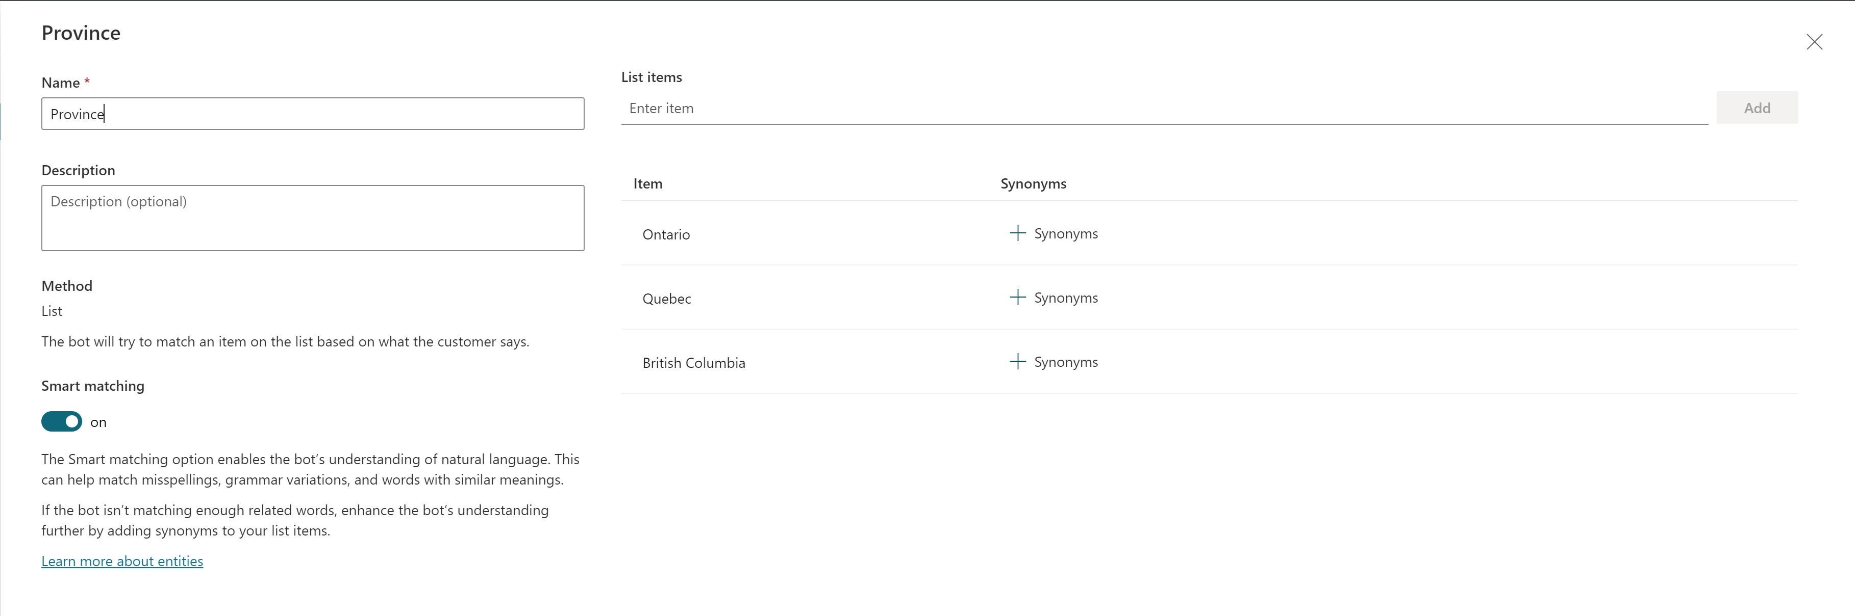
Notes:
You can also build your own entities as a list of possible values.
You can also use Smart Matching to allow the bot to find a matching entry even if it is misspelled.

Slide 62
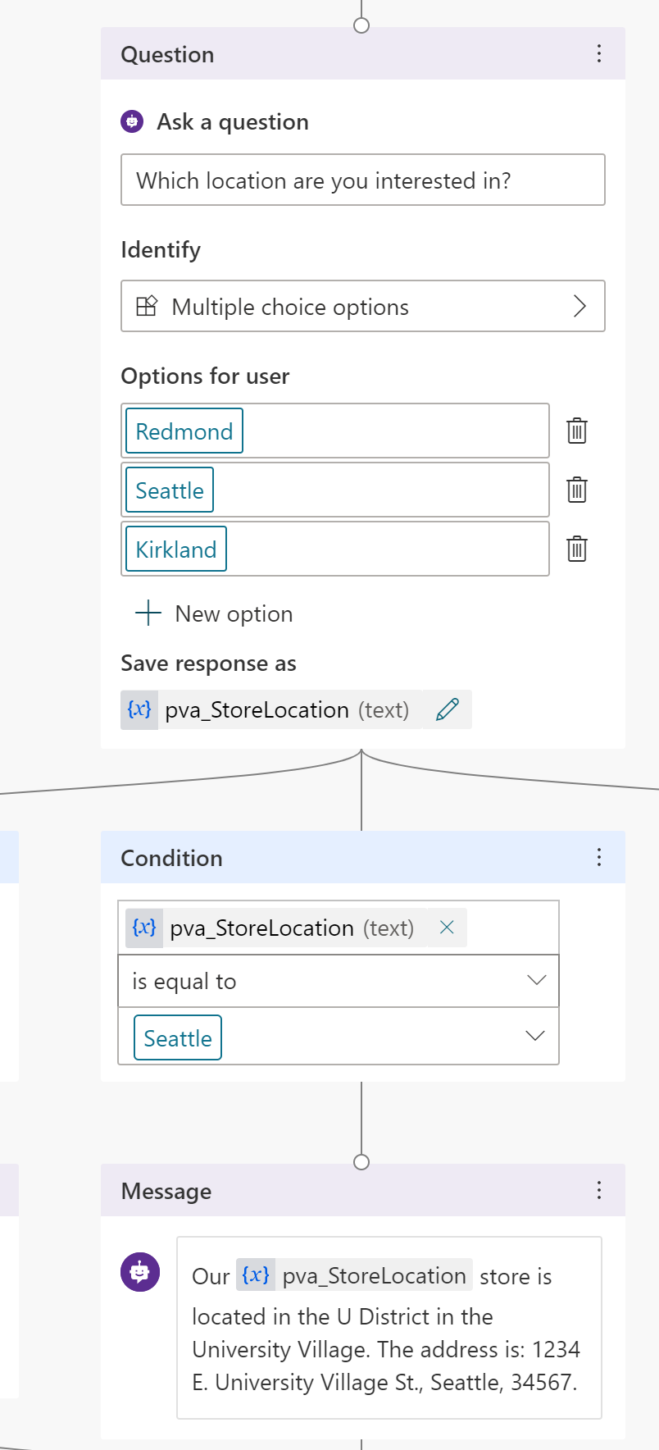
Notes:
Back in the authoring canvas, you can use the response to a question as a variable.
Then you can re-use the value of that response in your chat, either to make decisions or to output the choice back to the user.
You define the variable name under the Save response as field in the question action.

Slide 63
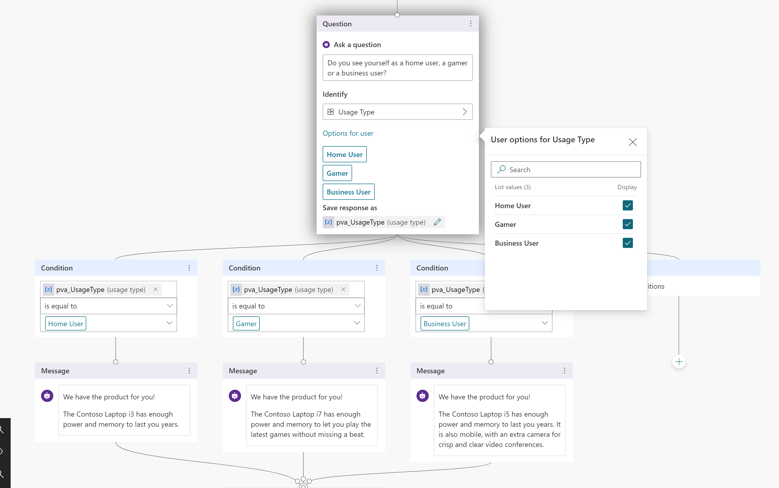
Notes:
When you use Entity type responses, you can also pick the acceptable values you want users to pick from by selecting the Options for user and checking the choices you want to offer.

Slide 64
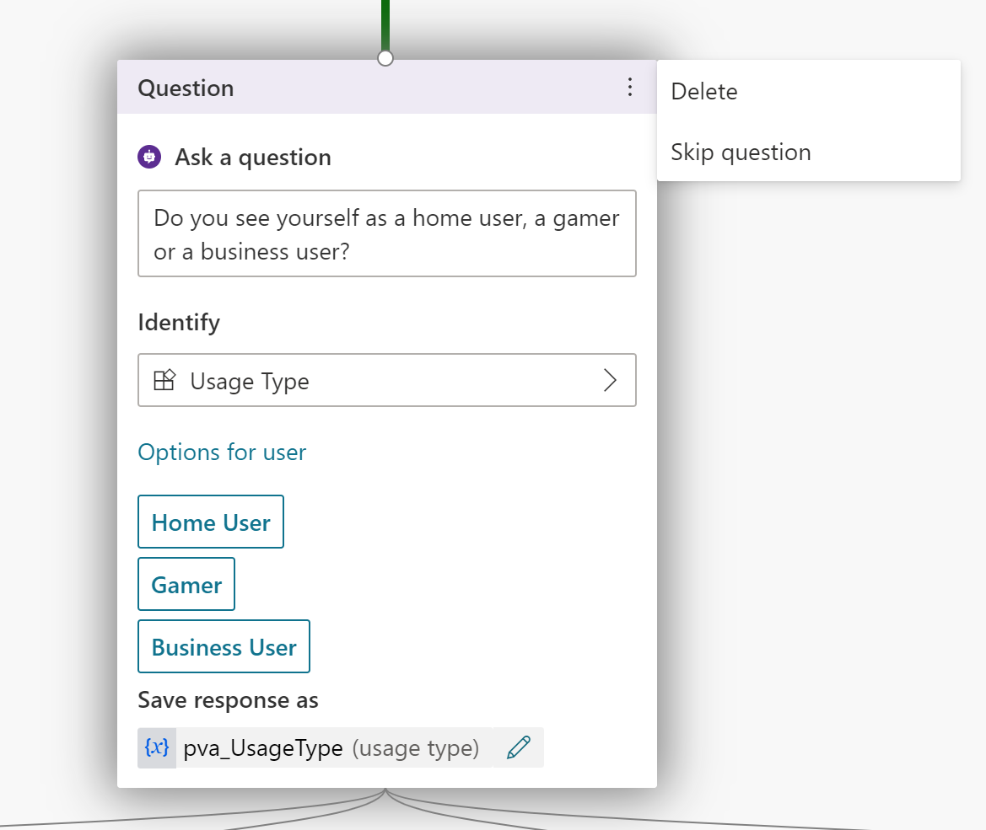
Notes:
To prevent the bot from being too repetitive repetitive you can opt to Skip question when the user has already answered the question.

Slide 65
Notes:
To prevent the bot from being too repetitive repetitive you can opt to Skip question when the user has already answered the question.

Slide 66
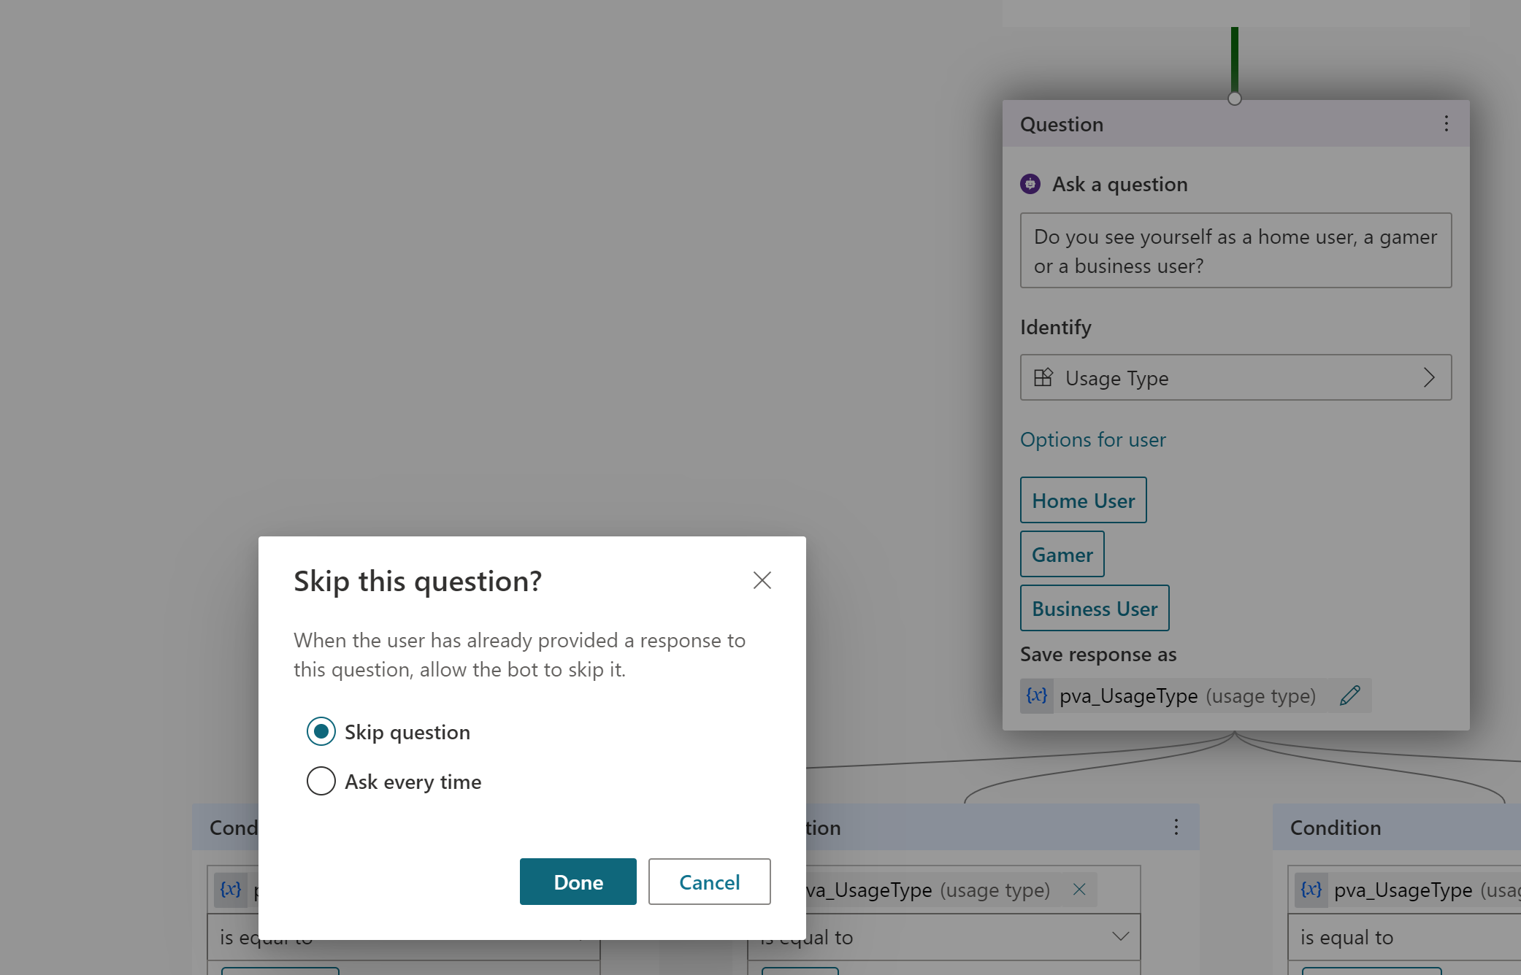
Notes:
For example, here we say Skip question if the user has already told us what type of user they are.

Slide 67
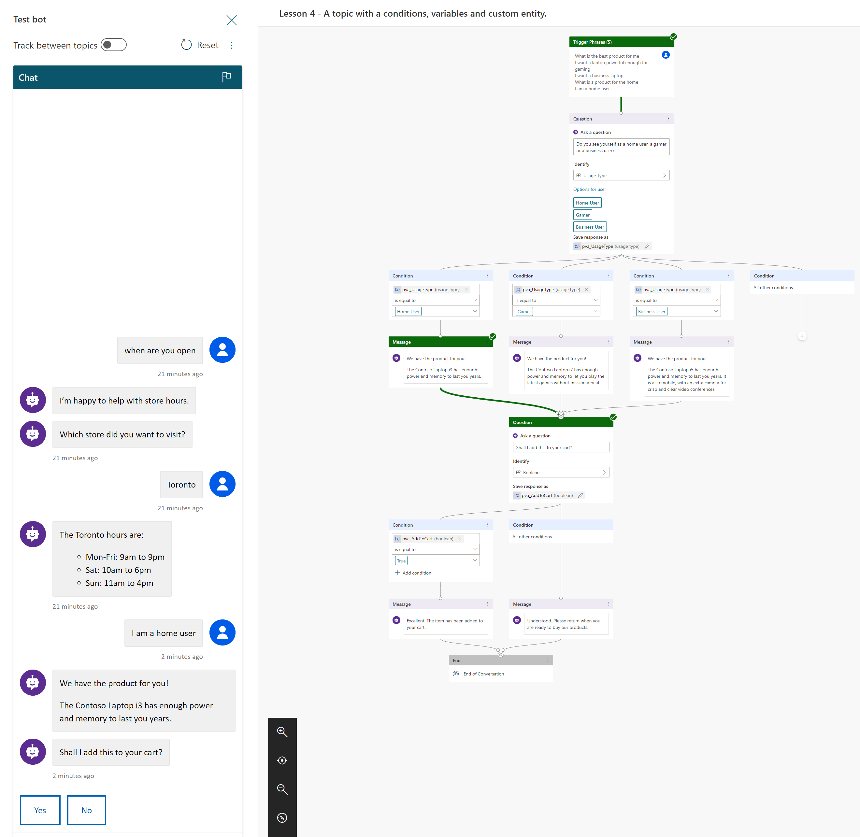
Notes:
Notice how when I typed I am a home user the bot automatically skipped to the next question and didn’t prompt what type of user I am.

Slide 68
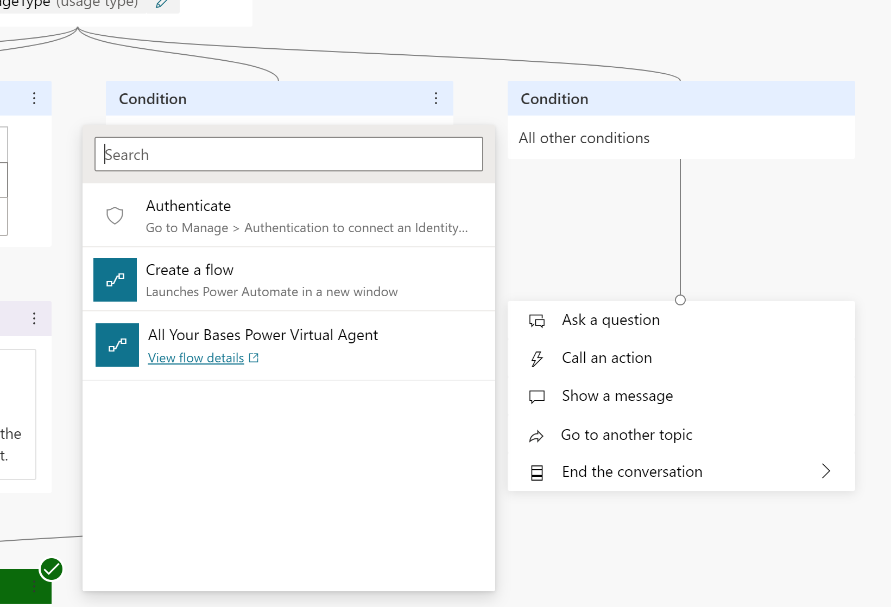
Notes:
Another type of action is Call an action, which will allow you to call your own Power Automate flow or Authenticate.
Both are outside of the scope of this presentation, but I’m happy to discuss either after the presentation.

Slide 69
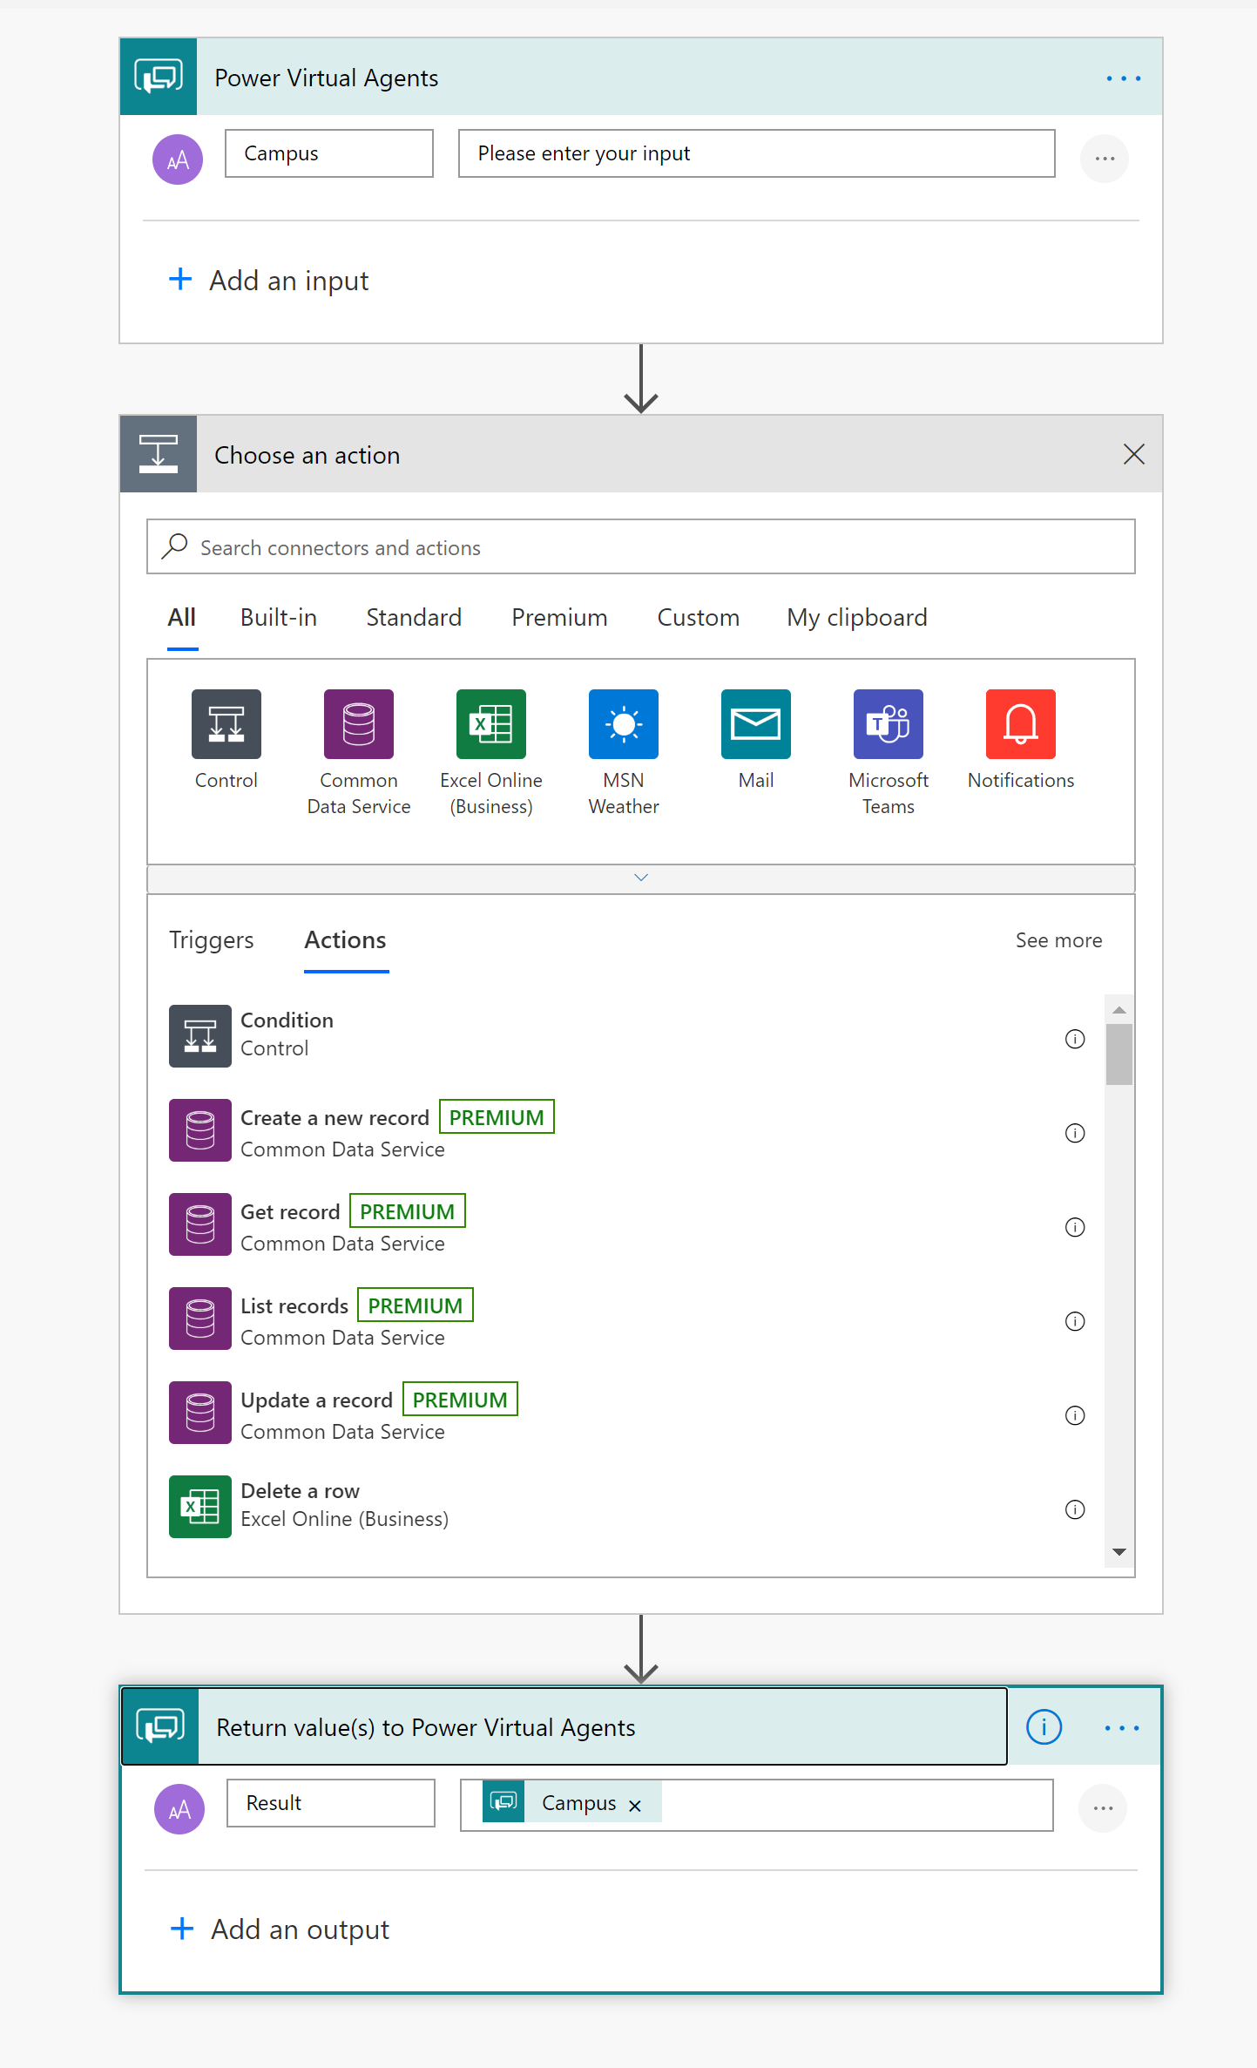
Notes:
What you should know is that calling a Power Automate flow allows you to pass parameters from Power Virtual Agent as Inputs.
You can then call any Power Automate action within your flow. For example, you could call your own APIs, read a database, or do any custom logic you want
You can also return Return values to your Power Virtual Agent.
For example, you could call your shipping company’s API to calculate shipping costs by using the person’s shipping address (Inputs) and return the expected costs to Power Virtual Agents (Return values)

Slide 70
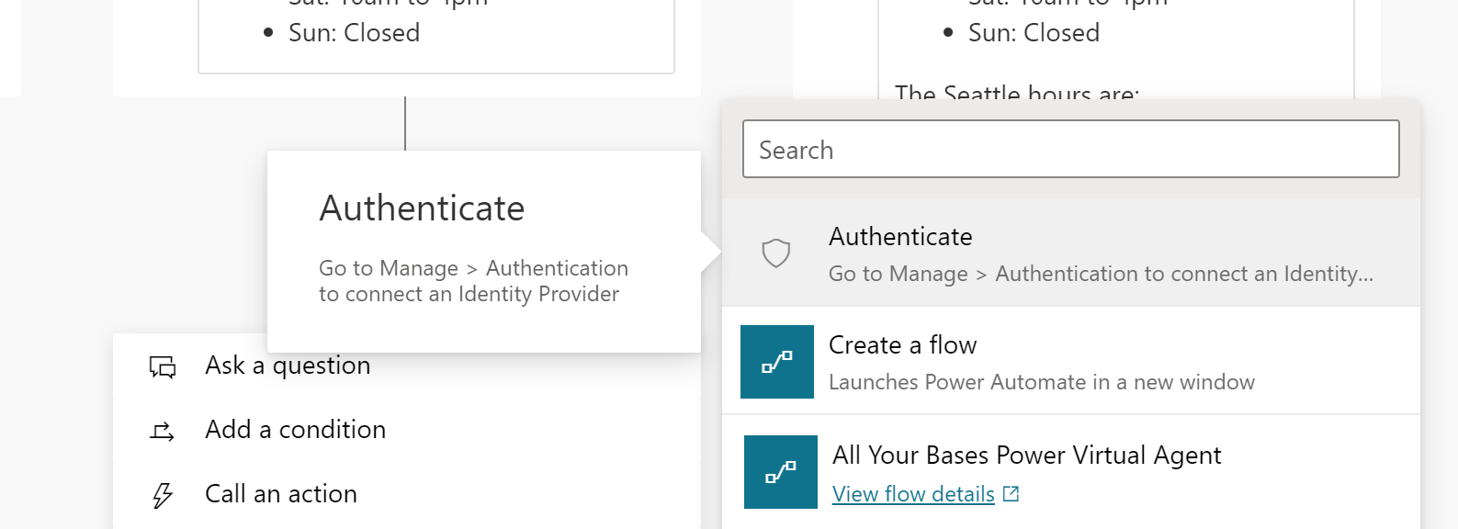
Notes:
You can also use any OAuth2 identity provider to authenticate the user by using the Authenticate action.
There are TONS of oauth providers out there, check out; https://en.wikipedia.org/wiki/List_of_OAuth_providers
The list includes Facebook, Twitter, Google, etc.
To find out how to set up authentication, see:
https://docs.microsoft.com/en-us/power-virtual-agents/configuration-end-user-authentication

Slide 71
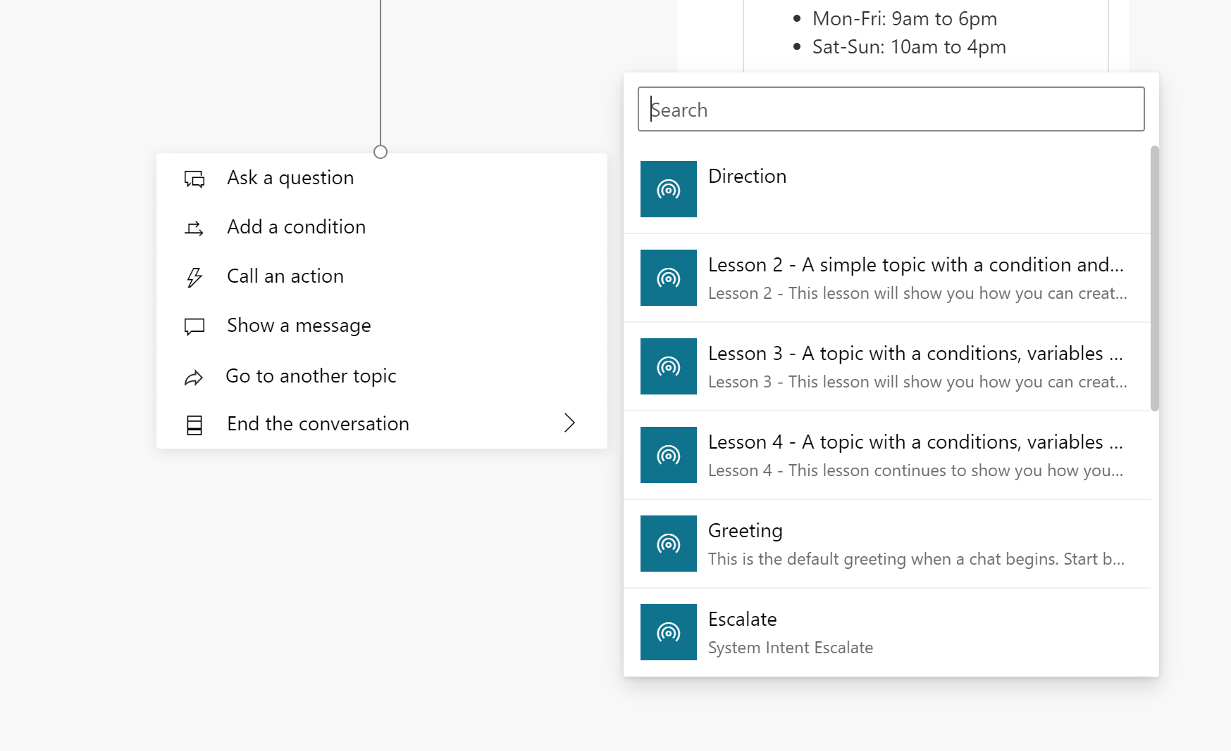
Notes:
Instead of repeating the same questions over an over again, you can chain topics together by using Go to another topic.

Slide 72
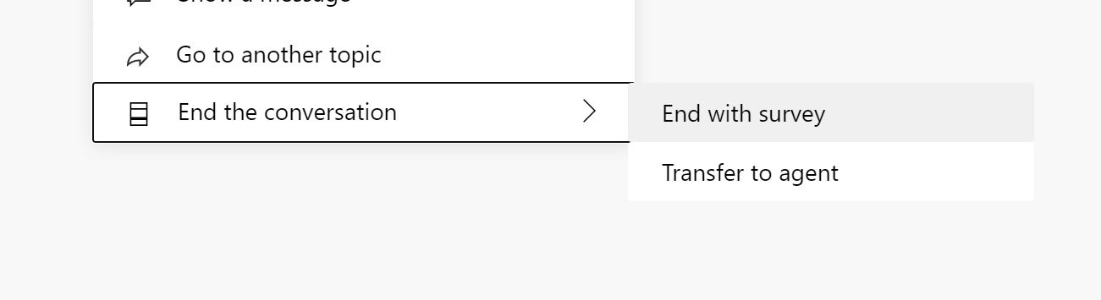
Notes:
Finally, at any point you can end the conversation by transferring to an agent or asking for a survey.

Slide 73
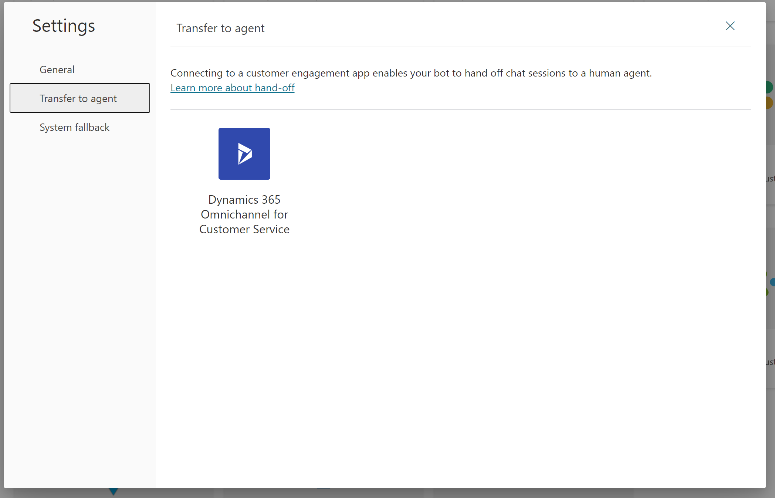
Notes:
Transferring to an agent requires Dynamics 365 Omnichannel for Customer Service
You can find out more at https://go.microsoft.com/fwlink/?linkid=2099038

Slide 74
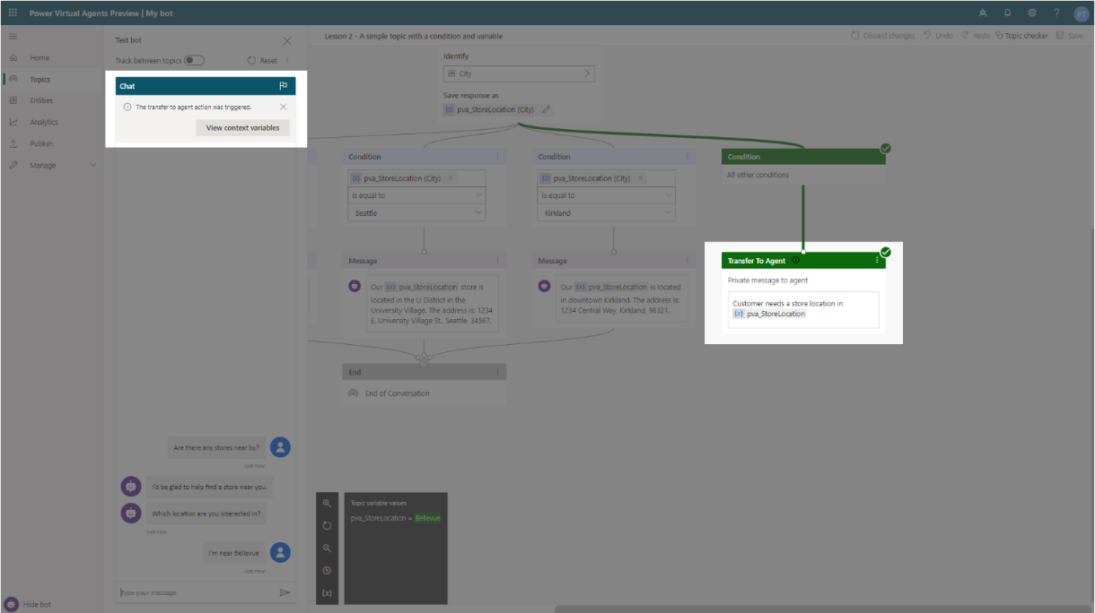
Notes:
When you transfer to an agent, you can build a context to explain to the agent what has happened. This prevents the agent from asking the same questions the user has already answered.

Slide 75
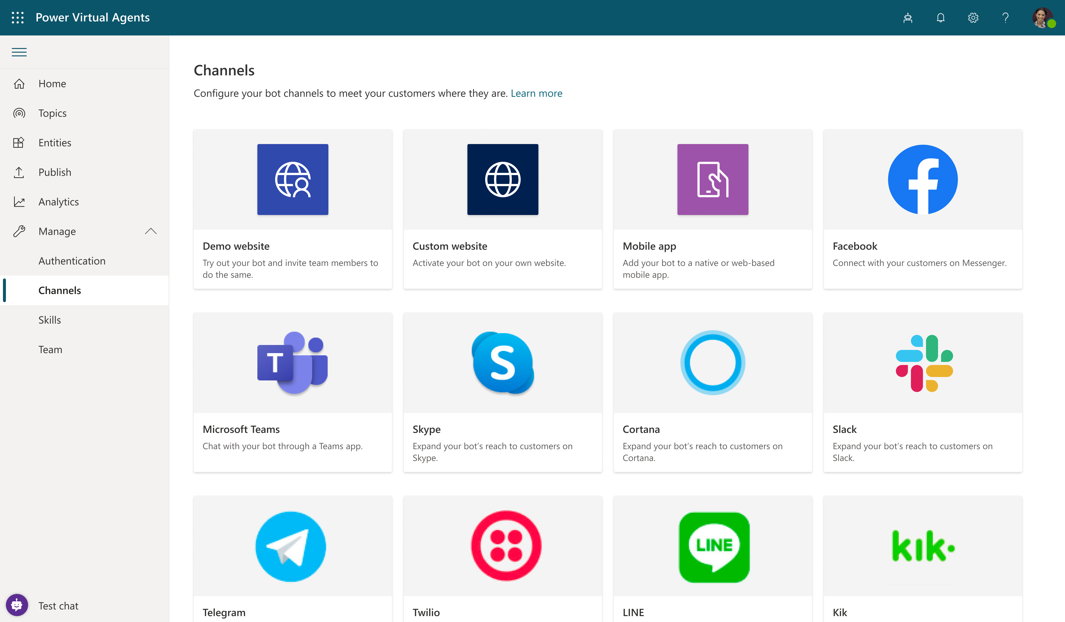
Notes:
Once you are done with building your bot, you can publish it to one of the many channels available out there.
You can embed it in a web site, an app, or use it within an application like Facebook, Teams, Slack, etc.
Check out https://docs.microsoft.com/en-us/power-virtual-agents/publication-fundamentals-publish-channels#configure-channels

Slide 76
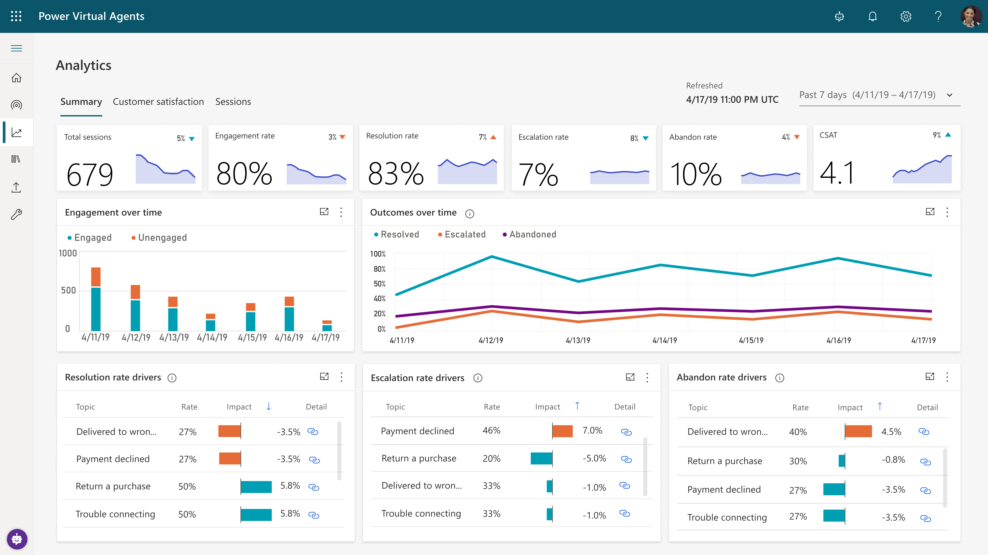
Notes:
Once your bot is published, you can use analytics to better understand how your bot is doing. It also helps you understand how you can improve customer satisfaction.

Slide 77
Pricing
$1,126.40
2,000 sessions per tenant/month
Notes:
https://go.microsoft.com/fwlink/?LinkId=2085130&clcid=0x409

Slide 78
Power Virtual Agents
What’s New
How to Buy
Product Licensing
Additional Support
Default Capacities
Resources
Top
Power Virtual Agents empowers teams to easily create powerful bots using a guided, no-code graphical interface without the need for data scientists or developers.
Base Offers
Base Offers | Power Virtual Agents
Purchase Requirement | No purchase requirements
Entitlements per tenant | 2K Chat sessions/tenant/month 10GB Database Capacity 20GB File Capacity 2GB Log Capacity Unlimited flow runs (only applicable for bot creation) See Power Apps, Power Automate and Power Virtual Agents Licensing Guide for a complete list
Additional Application | None.
Additional Capacity | Chat session add-on for Virtual Agents
$1,126.40
Power Virtual Agents
per tenant/month
Virtual Agents for
Dynamics 365
Customer Service
$1,239.04
per tenant/month
Session definition:
A session is an interaction between the customer and the bot, and represents one unit of consumption. The session begins when an authored topic is triggered. These sessions are referred to as ‘billed sessions’ in the product.
A topic ends in one of the following scenarios:
When all of the customer's questions are answered
When a customer intentionally ends or closes a chat session, or
When a bot is unable to answer adequately and the interaction is escalated to a live agent
Reference link for details.
Virtual Agents for Dynamics 365 Customer Service: More details from Dynamics 365 Licensing Deck

Slide 79
What’s a session?
An interaction between the customer and the bot
Represents one unit of consumption
Begins when an authored topic is triggered.
Deducted for both testing and production usage.
Ends in one of the following scenarios:
All of the customer's questions are answered
Customer intentionally ends or closes a chat session, or
Bot is unable to answer adequately and the interaction is escalated to a live agent

Slide 80
Any Questions?

Slide 81
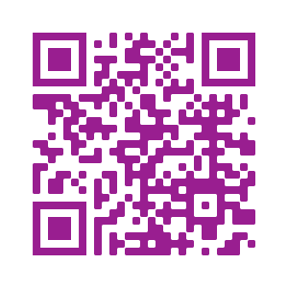
Please fill out the survey! & Win Swags!!
https://www.powerplatformbootcamp.com/survey

Slide 82
Thank You For Attending

